Slide 1
Bridging the Gap: Unified IAM and PAM Solutions​
Jernej Rezec, 22.5.2024
Notes:
Hello all, my name is Jernej. Todays presentation will be in English, but if you have any questions, you can ask it in Slovenian or Croatian or Serbian.

Slide 2
AGENDA
What is Identity and Access Management (IAM)
What is Privileged Access Management (PAM)
PAM vs IAM
Integration of IAM and PAM
Notes:
In the presentation we will quickly check what is IAM and what is PAM, then we will dive into advantages of integrating IAM and PAM.
Maybe just quick question before we start, please raise your hand, how many of you have PAM solution in the company, doesn’t matter Safeguard or any other?
How many of you have both solutions IAM an PAM?
Ok, thanks, lets start.

Slide 3


What is Identity and Access Management (IAM)
Identity and access management is the security discipline that enables the right individuals to access the right resources at the right times for the right reasons. (Gartner, Inc.)
you can prove it
Notes:
We are living in a time, where we change multiple companies and positions, which enable us to access various data which are more or less confidential. Here we can talk about our employee personal data, customer data, different financial reports, information about our product, which we want to hide from our competition.
To minimize risk of disclosure of information, we need to implement a system, which will limit access to those data or it will enable us to see who had access to those date at which point in time using audit tools.
System that enables us to do this is called Identity and access management or IAM.
If I simplify this it means, that we grant exact access in the time, when user needs them and we also revoke them once there is no need for them.

Slide 4
What is Privileged Access Management (PAM)
Privileged Access Management is a solution that helps to control, monitor and analyze the access to the critical infrastructure using privileged accounts.
Notes:
If the Identity Mangement is primarily responsible for managing user accounts and their permissions, the Privileged Access Management handles privileged user access to the systems itself with the elevated permissions for the time, such access is needed.
The term privileged access refers to higher level of permissions and it is required to do administrative tasks, managing critical systems and accessing sensitive data.
At the same time it helps to control, monitor and analyze behaviour of a user.

Slide 5
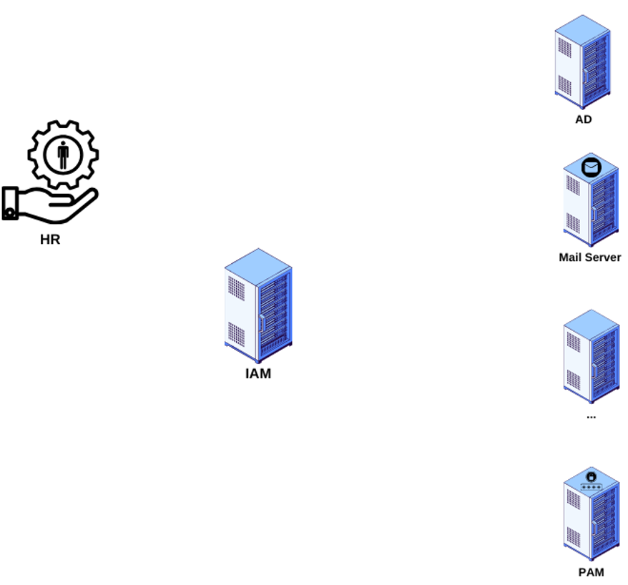
PAM vs IAM
PAM is standalone
component
IAM handles lifecycle
management of an
accounts including PAM
Notes:
So how PAM and IAM interacts with each other and what is the main difference then?
IAM is responsible for managing user lifecycle based on the HR data input, it create and modify accounts and their permissions in different target systems during Joiner, Mover and Leaver phase.
PAM on the other hand takes care of access to the critical systems with the elevated permissions.
The PAM is completely standalone system as we can see on the image and in relation to the IAM is no different than other target system – AD, Exchange, SAP, etc...
This means, that IAM based on the business logic creates accounts and grant needed accesses in the target system in right time and allow user to use PAM for accessing critical infrastructure.
Beside managing accounts and their permissions on the PAM, users gain all the functionalities of the IAM from web portal, audit trace, to the reporting tools.

Slide 6
Integration of One identity manager and Safeguard
Key features
Managing of accounts and their permissions
Request for passwords and sessions using web portal
Auditing
  Reports
  Attestations
Notes:
Lets check why would you like to integrate your PAM solution with the IAM. Key features are managing of accounts and permissions, you get all the auditing features of the IAM and you can use web portal for placing request for different accesses. Lets check some details about that.

Slide 7
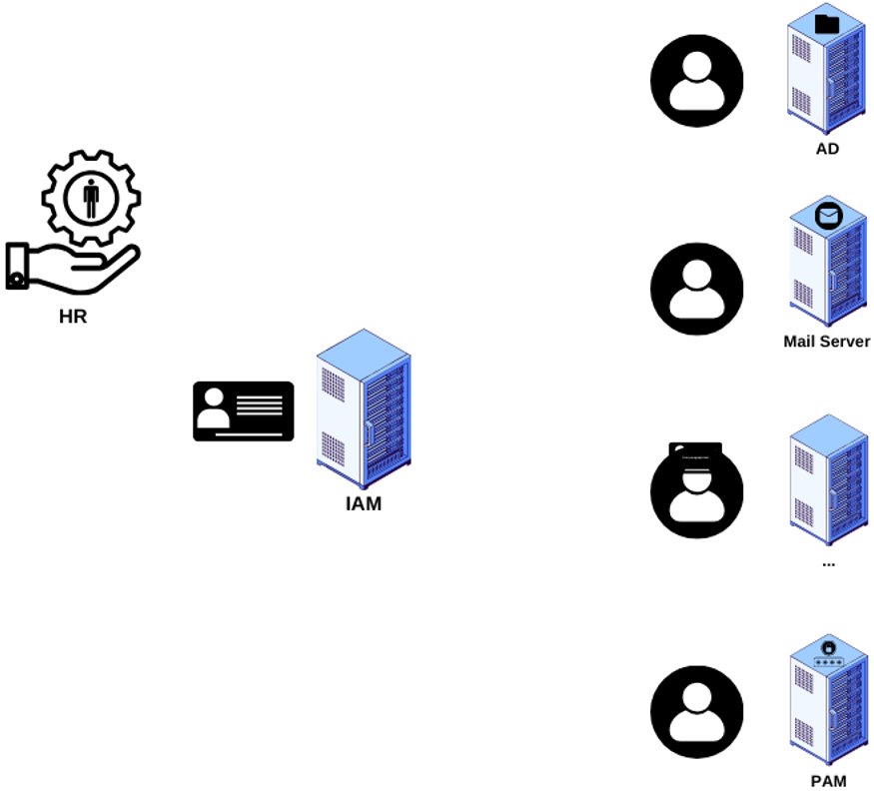
Managing of accounts and their permissions
HR as authoritative source
Creates account
Assign permissions and
asset access base on business
logic
Deprovision o permissions
when not needed
Notes:
First and probably most important step of integration is managing the accounts, that will use the PAM. IAM gets the information about employees from the authoritative source (HR data) and
based on the business logic user account are generated in the PAM and get the right permissions, which will allow user to access needed system using the privileged permissions.
User will get minimal required rights, to be able to do his job. At the same time, the IAM track any user change (mover or security risk) and will adjust account changes like, surname, email and or permissions.
At the end of the career , when user will leave the company, the IAM will also lock the account, revoke all the permissions from PAM and any other target system and will prevent any further usage.

Slide 8
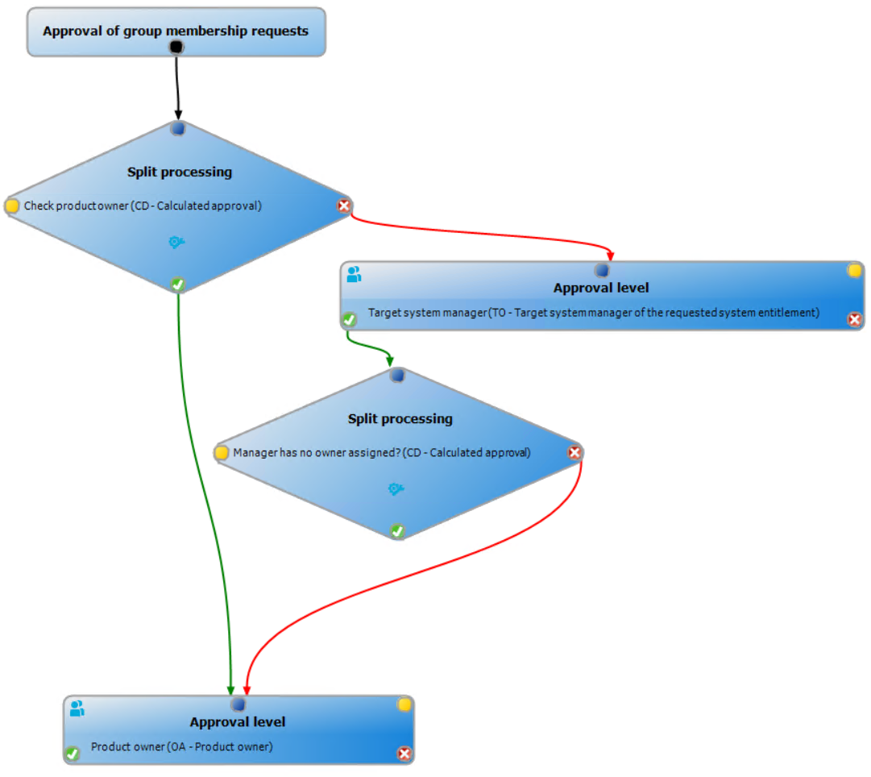
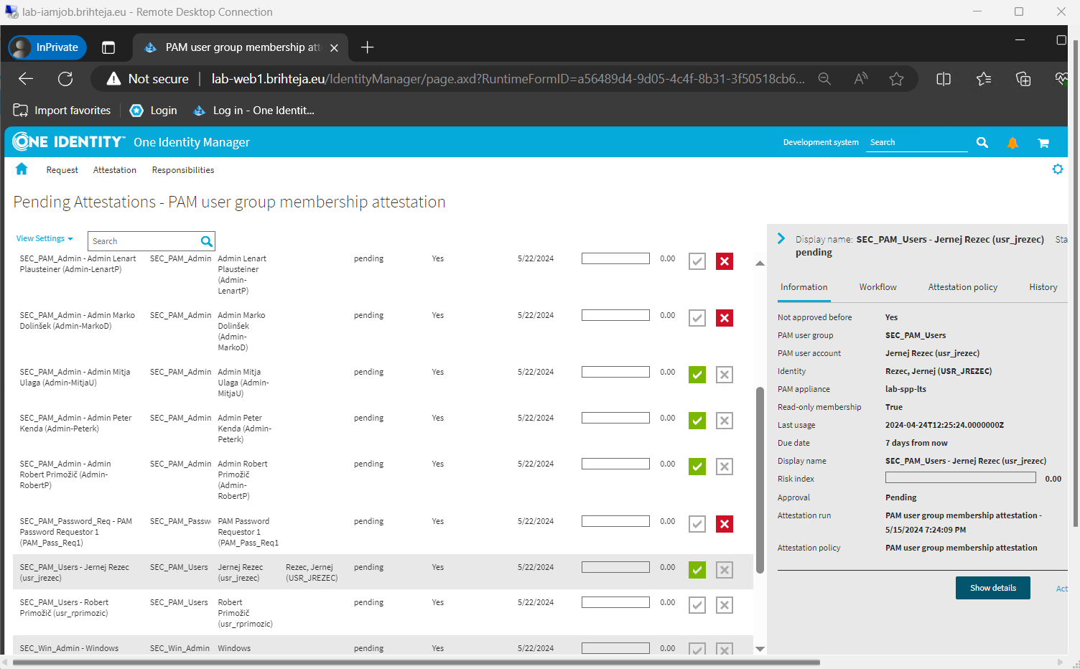
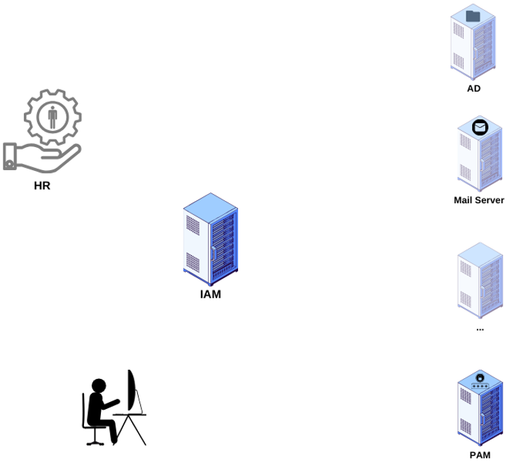
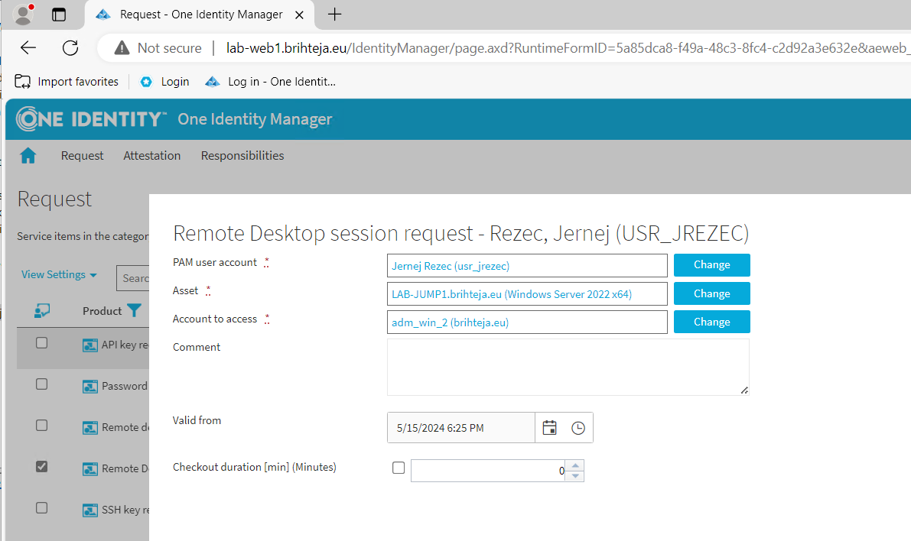
Request for passwords and sessions using web portal and auditing
Placing requests
in web portal
Attestations –
Certify correctness
of the permissions,
requests, etc.
Reports
Notes:
Another very useful features, that is gained by integrating PAM with IAM is that you can use IAM existing web portal. You can use it for requesting additional permissions for the PAM like for any other system, or you can us it to initialize the sessions (RDP session, password release, ssh). How it looks simple request for RDP session using the IAM web portal?
User goes to the Web portal, where he search for request for the RDP session.
He enters the basic data needed for session – he needs to select user with which he would like to login to PAM, he selects the asset (the server he is logging on), if server doesn’t supports logging in with his own account, he selects one of the available user which have required permissions.
He can also prepare the request for the future access (user can place multiple request in advance, if he knows, when he will need them).
Once he submits the request IAM will check if any approval is needed, if yes, IAM will notify proper approvers.
IAM gives you gain very powerful tool for creating workflows and approvals, you can have multiple steps with which can interact also with 3rd part apps (API calls, script calculations etc.).
Once approval part is done, IAM will create session request directly in the PAM.
User can now logon to the PAM or use the provided data in the email to initiate the session he requested. Connection to requested system is only able through the PAM system, which will monitor and record the session as required. Once the defined period expires, the access is automatically revoked.
The next advantage of integration are IAM built audit tools like reports and attestations. Preparing and maintaining the reports and attestations in IAM is quite simple and you have audit trail in one place, whit which you can always check when and why some user had an access to the system and who approved the access.
Reports can be prepared in any format from excel, word or PDF and are available in web porta or by email.
Attestations are a bit more advanced tools, that allows users that are responsible for compliance – mangers, different business owners to do the validation of the permissions, request or data on the demand (for example during the mover process) or schedule based.
For the PAM there are already some out of the box attestation defined, for attesting user accounts and their permissions.
Som of you probably think OK yes, but all major PAM tools offer their own portals for requests and managing workflow, but they are all quite limited in terms of modification. Integration with IAM allows end user and approvals, to use the existing web portal, which they uses for daily tasks and request.
At the same time you get the tool to audit all the request for all the target systems including PAM on one system.
So the PAM is only used for configuring access and accessing the privileged systems and monitoring the user behaviour.

Slide 9
What we have learned
Functions of IAM and PAM
Benefits of the integration
  Centralized management
  Improved security and compliance
  Audit trails
  Integrating IAM and PAM enhances security, simplifies access management, and ensures compliance by centralizing the control and monitoring of both regular and privileged user accounts.
Notes:
What we have learned today?
IAM ensures the right individuals have the right access to the right resources at the right times for the right reasons, managing user identities and their access permissions.
PAM focuses on controlling, monitoring, and analyzing access to critical infrastructure using privileged accounts.
Benefits of integrating the PAM with IAM
Centralized Management: Managing accounts and permissions through a unified system, leveraging HR as an authoritative source, ensuring minimal and necessary permissions for users.
Improved Security and Compliance: Utilizing IAM's audit and reporting tools to monitor access, certify permissions, and maintain compliance through regular attestations.
Audit Trails and Attestations: Generating comprehensive reports and audit trails, and conducting attestations to verify the correctness of permissions and access requests, ensuring all privileged access is properly monitored and validated at any time.

