Slide 1


THE EVOLVING
CYBER THREAT LANDSCAPE
Observations, insights and latest numbers & facts
Speaker
Dirk Wahlefeld
Head of Presales (USA and EMEA)

Slide 2

AGENDA
Deep Dive to the Changing Threat Landscape
The current situation
Trends observed in Europe
  Threat Actors to watch for
  Active Hacking Groups
  Active Campaigns
The challenges of cyber security posture
How to overcome

Slide 3












External Threat Landscape Management Platform
Founded in 2017 by ex-government intelligence head and CISO
AI/ML enabled, cloud native SaaS products – DeCYFIR and DeTCT
Backed by
Marquee Investors
Now Tech External Threat Intelligence Services
Q4, 2020
Recognized in Gartner Tech Radar and Trend Impact Report 2021
Recognized in Gartner Market Guide for Security Threat Intelligence 2020/2021
CYFIRMA Recognized for Intelligence-Led Cybersecurity by IDC 2021

Slide 4

Billions spent – in an endless race
Organisations Have Stepped Up Their Spend On Cybersecurity¹
Continuously Vulnerable To Cybercrimes Costing Trillions²
CAGR
9.4%
Information & Risk Management Spending
Cybercrime Costs Annually
Cyber-attackers continue to bypass the traditional/conventional cybersecurity products and solutions
¹Gartner Forecast Information Security and Risk Management, Worldwide 2018-2024 | ²Cybersecurity Ventures Cyberwarfare In The C-Suite 2021 Report

Slide 5

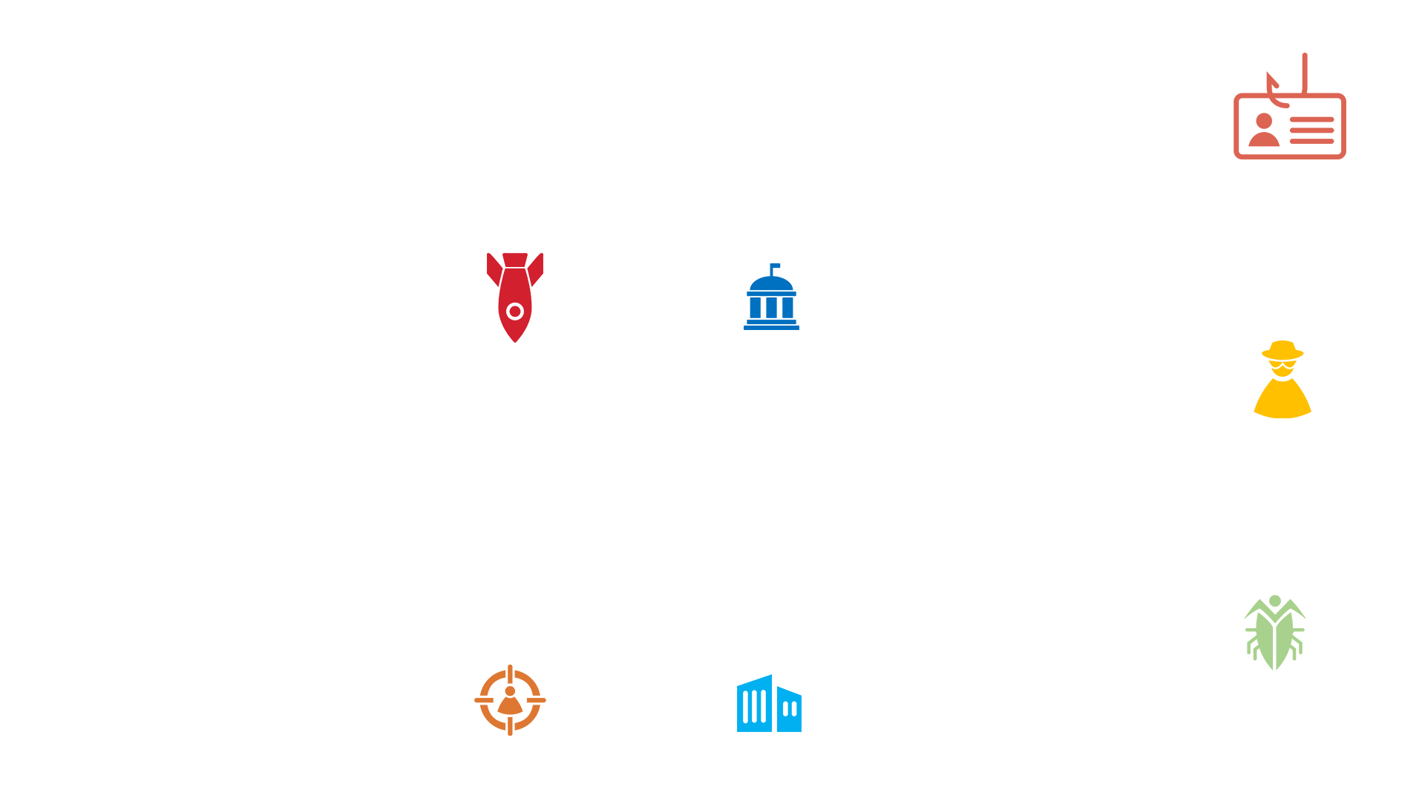

560%
173%
1,100%
Phishing
State-sponsored Attacks
Targets on Government Agencies
460%
Ransomware
Escalating
Cybercrime
497%
600%
CYBERATTACKS
IN 2021 VS 2020
300%
Targeted Attacks
Targets on Commercial Organizations
Malware
Source: CYFIRMA Research

Slide 6








Cyberwar and its Impact –
no one is spared
HOT TARGETS - CII/OT
Threat to critical infra, operational disruption, corporate espionage and reputational motives
FINANCIAL
Cybercrime needs funding. Cybercriminals are targeting financial systems
SUPPLY CHAIN DISRUPTION
Software supply chain will continue to be targeted
CYBERCRIMINALS COLLABORATE
Collaboration of cybercriminals have been there for while but now they are sharing infrastructure, arms, tools, and more
SMEs ARE NOT SPARED
Carpet bombing – businesses of all sizes are targeted
RANSOMWARE GROUPS COLLUDING
Naming and shaming techniques
Source: CYFIRMA Research

Slide 7
Cybercriminals are now focusing on kinetic cyberattacks
Uptick in state-sponsored attacks triggered by geo-political tensions
The Evolving Threat Landscape
Ransomware menace escalates
Deepfake technology to spread misinformation

Slide 8






Cybercriminals have been very active in manufacturing, automobile, and retail companies
Trend: Using specialized malwares and impersonation of identities
Target: Identity theft
Motive to exfiltrate intellectual property from automobile, chemical and food & beverage
Trend: Spyware, malware and plug-ins to collect pattern and environmental behavior
Target: IP and trade secrets using identity theft
Adversaries of cosmetic and online businesses are capitalizing as they are easy targets with high resell value
Trend: Passive and active scans identification of porous attack surface and Internet-accessible assets
Target: Trade secrets and chemical composition using impersonation
Trends Observed in the European Threat Landscape

Slide 9
Managed service providers will continue to be high-profile targets for cybercriminals
Trend: Ransomware and data exfiltration malware
Target: Sensitive and identity data
Large engineering companies are targets for IP and proprietary data
Trend: Ransomware and data exfiltration malware
Target: Sensitive and identity data
Supply chain of manufacturing, tourism, utility companies are at risk
Trend: Multi-Behavioral malware [IT/OT, different operating systems]
Target: CII, trade secrets, documents containing proprietary processes
Trends Observed in the European Threat Landscape

Slide 10



Financial services including insurance and trading companies are targeted
Trend: Whitelisted application impersonation, data exfiltration malwares and ransomware attacks
Target: Impersonation of identities and theft of identity data
Consumer Goods and Pharma companies are targeted for their trade secrets
Trend: Browser plug-in, ransomware and data exfiltration malware
Target: Sensitive and identity data
Scammers are actively spreading false information to collect PII / behavior data.
Trend: Fake sites, Internet downloadable spyware
Target: Sensitive and identity data
Trends Observed in the European Threat Landscape

Slide 11
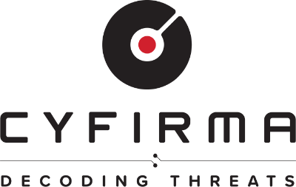

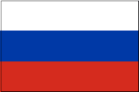
The European Threat Landscape
Nation-state / Threat Actors to watch for
LAZARUS GROUP
TA505
A recent shift in TA505's focus towards ransomware and extortion.
Believed to have an infrastructure overlap with other threat actors, TA505 has been observed leveraging a wide range of malware as part of their campaigns.
TA505 has been lately observed renewing their attack tactics, including the deployment of retooled intermediate loader stages scripted in Rebol and KiXtart, which are used instead of the previously popular Get2 downloader, and a constantly updated version of FlawedGrace remote access trojan (RAT).
Lazarus Group is a nation-state adversary from the Democratic People’s Republic of Korea (DPRK).
Their operations are conducted by Bureau 39 of Korean Workers' Party with hacking part of the operations managed by the Bureau 121 of Reconnaissance General Bureau (RGB).
Bureau 121 consists of multiple units all included and tracked in APT38 – Lazarus Group.
Unit 180 is believed to be dedicated to obtaining currency for the regime. Lazarus Group is capable of rapidly developing, mutating, and evolving existing exploits/malware in their malware development unit.
Recently, they are targeting crypto currency exchange companies.
APT41/MISSION 2025
The APT41 group is well-resourced, highly skilled, creative, and agile, adapting quickly to any attempts by its targets to remediate infections.
APT41 compromises are typically widespread and highly persistent with the group able to fight to take care of its foothold inside networks.
Unlike previous campaigns where the group used phishing emails or Trojan malware, its attacks have evolved targeting vulnerable systems and devices that were directly exposed to the internet.
Source: CYFIRMA Research

Slide 12
The European Threat Landscape
Active Hacking Groups to watch for
Lapsus$ Group
Conti Ransomware
LockBit 2.0 Ransomware
Probably the newest yet the most menacing group in recent times. The group has claimed to have compromised and posted the source code of Microsoft, Samsung, Nvidia, and - the latest - Okta - in three months.
Classified as an extortion actor, Lapsus$ breaches corporate networks, exfiltrate sensitive data, and demands a ransom in return for not leaking the information online.
The group also operates a Telegram channel to reveal its victims' names. Lapsus$ has also claimed to engage in data wiping activities against its targets.
Conti is often claimed to be a Russian state-sponsored operator, and this was evident when Conti openly warned those conducting offensive cyber operations against Russia.
Affiliates of the Conti operation have been behind a significant number of recent attacks and with Conti appearing to recruit many of their former affiliates, their operations are further estimated to surge in 2022 and beyond.
LockBit 2.0 operates as an affiliate-based Ransomware-as-a-Service (RaaS)
Employs a wide variety of tactics, techniques, and procedures (TTPs), creating significant challenges for defense and mitigation.
Its affiliate-based model means cybercriminals with lesser technical knowledge can also deploy this ransomware to target businesses across various established markets in Europe.
Source: CYFIRMA Research

Slide 13
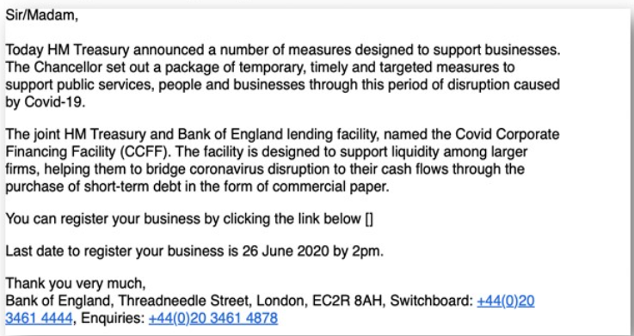
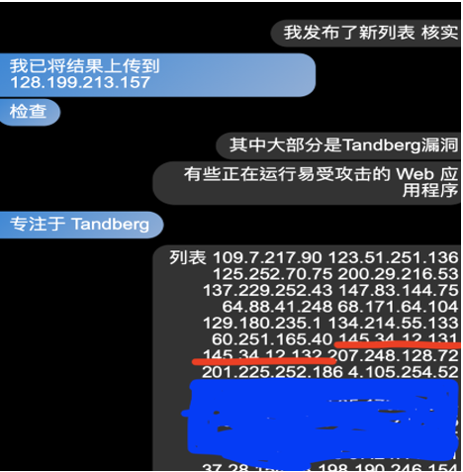
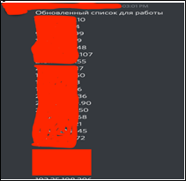
The European Threat Landscape
Active Hacking Campaigns to watch for
think pocket (APT41/MISSION2025)
Motivation: Exfiltration sensitive information and intellectual property.
Target Industries: Telecommunication companies and infrastructure providers, Energy production and supply companies, defense establishment, large conglomerate, global Embassies, research, automobile, Manufacturing, ICT and trading companies.
Target Geographies: USA, UK, Japan, Philippines, Taiwan, India and Australia.
Skills and Expertise: C, C++, Java, Ruby and Python.
Suspected Location: China [Beijing, Chengde, Hezhou, Guangzhou] and USA, Taiwan
Cybercrime community: zcqmnsvwybgsuwxd.onion [historically affiliated with APT41].
Handlers: 神之铠甲, 长19and 婴儿潮 [All 3 handler we have tracking from last 8 months being associated with APT41].
Screenshot:
Global Covid-19 Phishing campaign (LAZARUS GROUP)
Motivation: Financial Benefits, Espionage.
Target Industries: Private organizations, Government Entities, Individuals.
Target Geographies: USA, UK, Japan, India, Singapore, South Korea
Methods Discussed by hackers: Phishing emails, Impersonating websites, fake email Ids
Skills and Expertise: MS Visual, C++.
Suspected Location: North Korea and many other parts of the world.
Screenshots:
night blood (TA505)
Motivation: Exfiltration of sensitive information, system, and customer information for financial gains; Demand ransom.
Target Industries: Manufacturing, Food & Beverages, Financials, Real Estate & Infrastructure, Rubber, Insurance, Trading Platforms, Exchange Systems, Retail, Online Stores, Electronics, Telecommunication, ICT Services, Research, Chemical & Cosmetics, Government.
Target Geographies: Japan, UK, Australia, South Korea, USA, India, Thailand, Singapore, Germany, Spain.
Skills and Expertise: Java, JavaScript, C++, Remote Code Exploit.
Methods Discussed by hackers: Exploit weakness in the applications, Operating System, Implanting Ransomware, Malware and Trojan, Encrypt files & folders.
Screenshots:
Source: CYFIRMA Research

Slide 14
The European Threat Landscape
Active Malware to watch for
TinyMet
(TA505)
The tools used in the attacks in Western Europe against two organizations operating in pharmaceutical and manufacturing industries in late January 2020, were traced to Silence and TA505.
2 other executables had likely been deployed during the European campaign: an LPE exploit for CVE-2019-1405 and CVE-2019-1322 (comahawk.exe) and a Meterpreter stager TinyMet.
TinyMet was compressed using a packer developed by TA505.
TinyMet is an open-source Meterpreter-based reverse shell, providing the attackers with access to the target host.
TTP's: Vulnerabilities & Exploits.
Target geography: Belgium, Germany.
Target technology: Windows.
Associated campaign: night blood.
Sidewalk Backdoor (APT41/MISSION2025)
Attack exposed Microsoft Exchange and MySQL servers.
PowerShell commands use to install an unidentified web shell.
Malicious backdoor executed. After the installation of the backdoor, the attackers deployed a custom version of the credential-dumping tool Mimikatz.
TTP's: Process Injection, Data Encryption, Data Exfiltration.
Target industry: Diversified Consumer Services, Government, Media.
Target technology: Cloudflare, Google.
Associated campaign: think pocket, UNC036.
Unnamed malware (JS-sniffers) (LAZARUS GROUP)
A campaign dubbed clientToken=
Targeting US and European online shops
Using JavaScript sniffers (JS-sniffers)
Another campaign dubbed BTC Changer was discovered, and it involved the same infrastructure
TA steals crypto using a set of new tools
Attack online stores using crypto skimmers (modified JS-sniffers) which accept crypto payment
TTP’s: Credential harvesting, Malware/Trojan implant, Website compromise.
Target industry: Online Shopping, Cryptocurrency Platforms.
Target technology: JavaScript, Web Application, Windows.
Associated campaign: Mud Nationals.
Source: CYFIRMA Research

Slide 15





Why do cyberattacks continue to be successful?
NO VISIBILITY ON EXTERNAL THREAT LANDSCAPE
INWARD-LOOKING WAY OF MANAGING CYBER POSTURE
Uptrend in Cybercrime
‘Events-Focused’ approach is simply not effective
No contextual details
And more..
LIMITED AWARENESS ON SHADOW IT, BRAND RISK
EXPANDING CONNECTED 3RD PARTY SYSTEMS
EXTENSIVE EXPLOITABLE DIGITAL FOOTPRINT
COMPLEX CYBERSECURITY SYSTEMS AND CONTROLS

Slide 16
How to defend against evolving cybercrime and threat landscape
Visibility of external threat landscape and apply that into your cyber posture management
Identify your digital footprint
Strategy for Identity and continuous monitoring, validation
Know and monitor your shadow IT/OT/IoT
Situational awareness, what is going on in your industry, technology and geo location
Understanding of risk and impact
Don’t be in this mode “can’t happen to me”
Preparedness and Readiness in the best remedy

Slide 17






Comprehensive External Threat Landscape
External Attack Surface Discovery
Vulnerability Intelligence
Brand
Intelligence
Digital Risk Discovery & Protection
Situational
Awareness
Cyber
Intelligence
Discover external-facing assets, process and people weakness exploitable by hackers Provide insights on redundant & shadow IT, cloud instances, configurational weakness, third-party attack surfaces | Threat-led vulnerability enrichment based on changing external cyber environment. Reprioritization of identified vulnerabilities based on cybercriminals interest, attribution and association Help clients take proactive actions by prioritizing remediations and strengthening controls | Monitor brand, product & service, executive infringement and connect with ongoing cybercrime campaigns Provide real-time third-party risk assessment & ensures brand integrity, closing all the blind spots | Round-the-clock dark web, deep web, surface web and social media monitoring for data and identities leaks, confidential files, source code, sensitive information exposure, impersonation of domain, assets and information, phishing and malware campaigns Reveal digital profile exposures, & proactively uncover risks associated to data leaks, breaches | Understand cyber trends & threats specific to client's industry, technology & geos Provide insights on cyber threats to help clients to realign their cyber posture | Predictive, personalized, contextual, actionable outside-In and multi-layered cyber intelligence Insights address the who, why, what, when & how of the attacks

Slide 18

Let’s go back to basics
Know your enemies
-> You need to know what you are up against (Cyber Intelligence)
Know yourself
-> You need to know how attractive you look through the lens of the hacker from the outside (Attack Surface, Digital Footprint, Weaknesses, Path to Attack)

Slide 19
So, what can we do?
Stay ahead of cybercriminals and be prepared to mitigate and counter emerging threats!

Slide 20
Next steps?
Free trial of CYFIRMA’s DeTCT

Slide 21
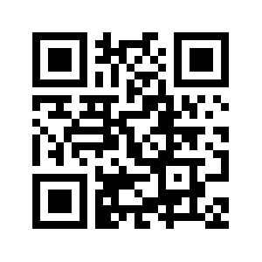
LET’S GET IN TOUCH
www.cyfirma.com

