Slide 1
Kam gre slovenski IKT? Quo Vadis ICT Slovenia
Nenad Šutanovac, director of ZIT, Ljubljana, May 22th 24

Slide 2
Slovene ICT in numbers
ICT = cca. 4.5% of GDP of Slovenia
DESI indey: the economy – average digital maturity compared to EU
Total cca. 45.000 ICT specialists employed in Slovenia (2022)
By 2030, to join top (5) leading digital countries in EU

Slide 3
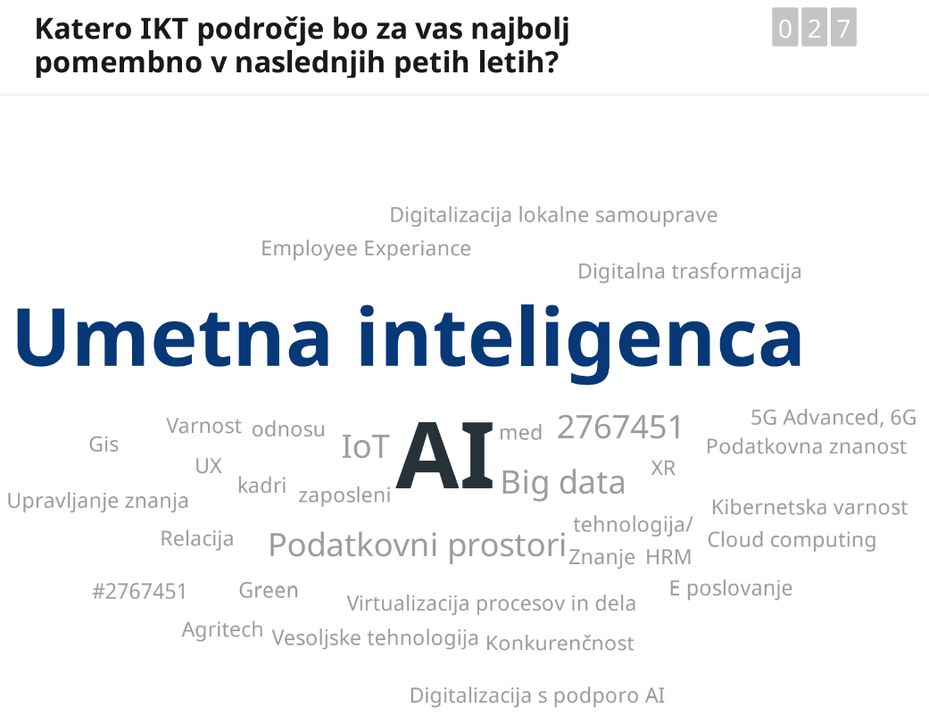

Slido - Slovene ICT: What ICT area will be most important in the next 5 years

Slide 4
Market atractiveness / Capabilities and Skills of ICT in Slovenia (v0.9 - Preliminary)
Intenzivno razvijati
High
Selektiven razvoj
Market attractiviness
Average
Ohraniti ali dezinvestirati
Low
Low
Average
High
Capabilities and skills
Notes:
Rezultat prve faze „desk research“
Nekaj področij še manjka (blockchain, digital twin, …)
Nekaj dodatnih podatkovnih virov je potrebno še obdelati (planirani nacionalni instrumenti, prijavljeni patenti, fokus na članstvu, anketa)

Slide 5
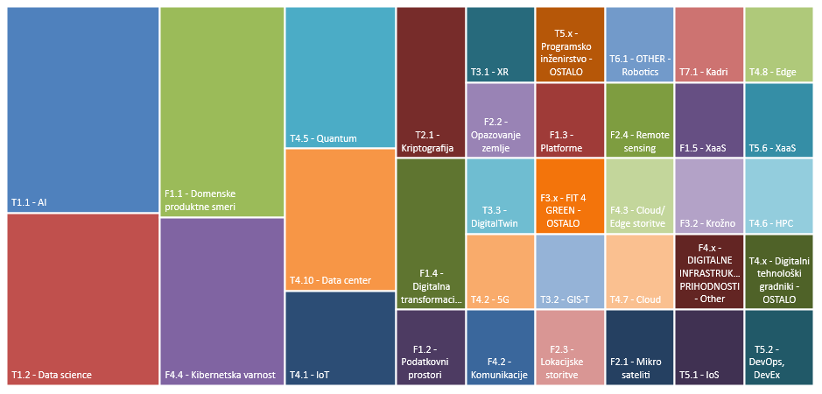
Areas mostly supported by Horizon Europe and Digital Europe Programme (2023-2024)

Slide 6
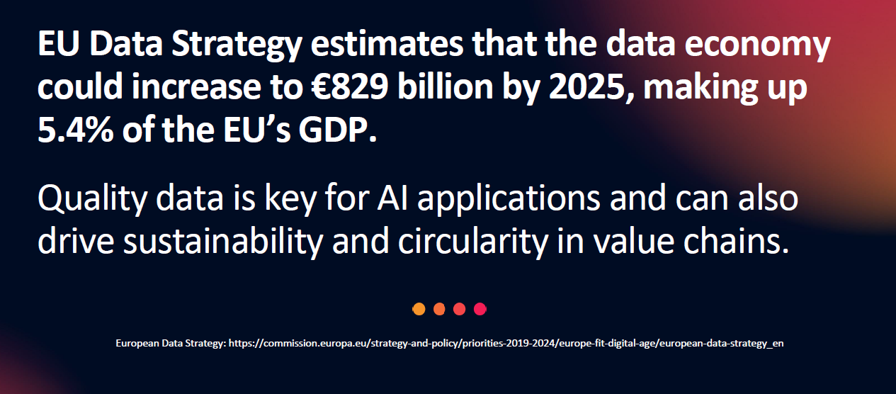

Slide 8
Is AI an opportunity for Slovenia and Slovene ICT sector?

Slide 9
Why Slovenia (research…) 1/2
Started in 70s, with dr. Ivan Bratko, still strong today (IJS, FRI, FERI, …),
Very high number of researchers per capita globally,
IRCAI – Unesco international AI research center located in Slovenia
Slovene researchers play important role internationally, cooperating with Slovenia (Jure Leskovec / Stanford, Marinka Žitnik / Harvard, …) ​
National Program for Artificial Intelligence confirmed by the governement in 2022
Slovene center for AI implementation (planned by the Ministry for digital transformation in 2024)
Projects in progress:
  OECD / National AI Observatory
  Building Slovene LLM by a consortium (FRI, …): (PoVeJMo)

Slide 10
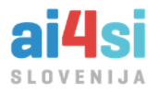

Why Slovenia (ICT) 2/2
High level of knowledge, skills, services in Slovenia, competitive solutions
Ai4si – AI for Slovenia, by ICT Association of Slovenia to promote implementation of AI solutions (from 2021)
„Slovenia – Premier Hub for Data and AI Innovation“
Number of state of the art implementation projects in Slovenia, also winners of GoDigital prize for best national digital project in areas of LLM/generative AI, domain AI models / decision support, digital twins, pattern recognition/computer vision/quality control, AR/VR, …
ZIT - Part of Common Data Spaces initiatives and Data Economy initatives
We have just established Slovene Smart Specialisation Partnership: GoDigital, to boost the development of ICT Sector (with AI in focus)
Guide (in Slovene language): How to implement AI in SMB

Slide 11
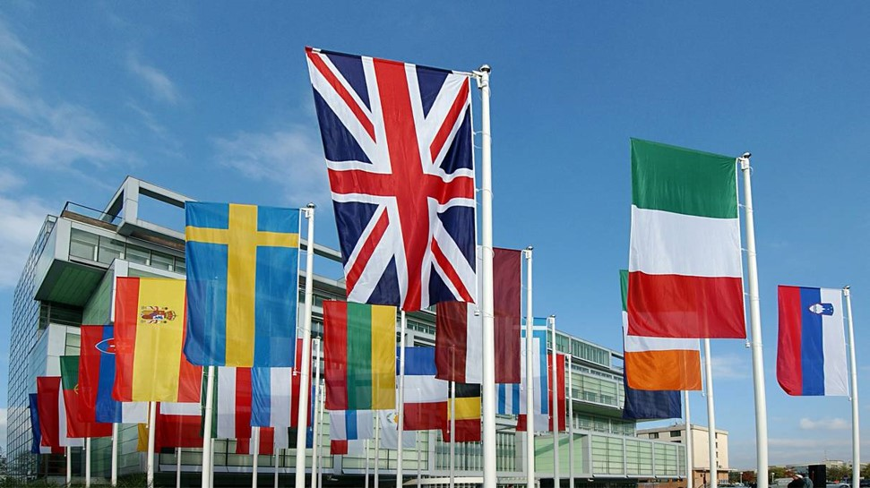
Quo Vadis ICT Slovenia ?
THANK YOU
Nenad.sutanovac@gzs.si; zit@gzs.si;

