Slide 1


NIS2 – not only an obligation, but also an opportunity
Urzica Olivér – Country manager
22.05.2024, Celje

Slide 2

Cybersecurity awareness, rise of insider threats | Supply chain attacks | Stronger focus on critical infrastructures | IT/OT/IoT unified Management
Integrating Customer Data Platform |  |  | SOCs in highlights, more demand
External Cyber Threat Intelligence |  |  | Edge computing
Metaverse, Augmented Reality, and Virtual Reality |  |  | Data Governance (data driven business)
Identity Theft/ Impersonation |  |  | Cost effective security platform consolidation
Ransomware and phishing attacks | Implementation of Cyber Security Regulations | Focus on automation and visibility/observability | Adoption of AI/ML/UEBA
TRENDS OUTLOOK
2024
SECURING THE FUTURE!

Slide 3



NIS2 – not only an obligation, but also an opportunity
INNOVATION
COMPETITIVE ADVANTAGE
STRONG COOPERATION
RESOURCE OPTIMISATION
RESILIENCE
Focus topics:
Prevent and remediate detected attacks
Ability to recognize, analyse and respond to incidents
Provision of reporting obligations
Ability to report as soon as possible (early forecast within 24 hours - event notification within 72 hours - submission of final report within 30 days)
Protection
Business-continuity
Trust
Reducing cyber security risks
Guaranteeing the continuity of services
Increasing trust between actors in the supply chain
Notes:
A megfelelőség nem csak jogi kötelezettség, hanem lehetőség is a szervezetek számára, hogy felülvizsgálják és erősítsék kiberbiztonsági gyakorlataikat, és így jobban megvédjék magukat a lehetséges támadásokkal szemben.
Szívesen teszünk javaslatokat a meglévő biztonsági politikák felülvizsgálatára, a hiányosságok azonosítására, és támogatjuk az irányelvvel összhangban álló új protokollok kidolgozását.

Slide 4


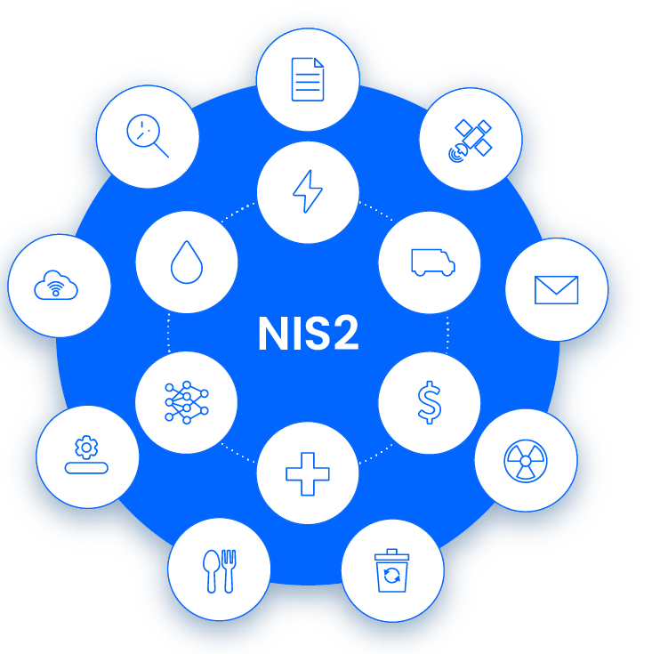






NIS2 requirement guide summary
System and information integrity
System and communication protection
Protection of data carriers
Configuration management
Maintenance
Program management
Risk analysis
Planning
Logmanagement and Accountability
Security incident management
Evaluation, authorization and monitoring
Contingency planning
Physical and environmental protection
Awareness and training
Personal safety
System and service procurement
Supply chain risk management
Identity and access management
Identification and authentication

Slide 5
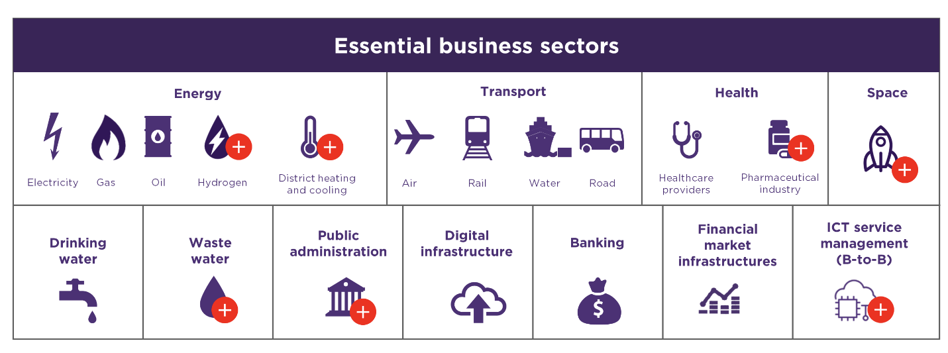

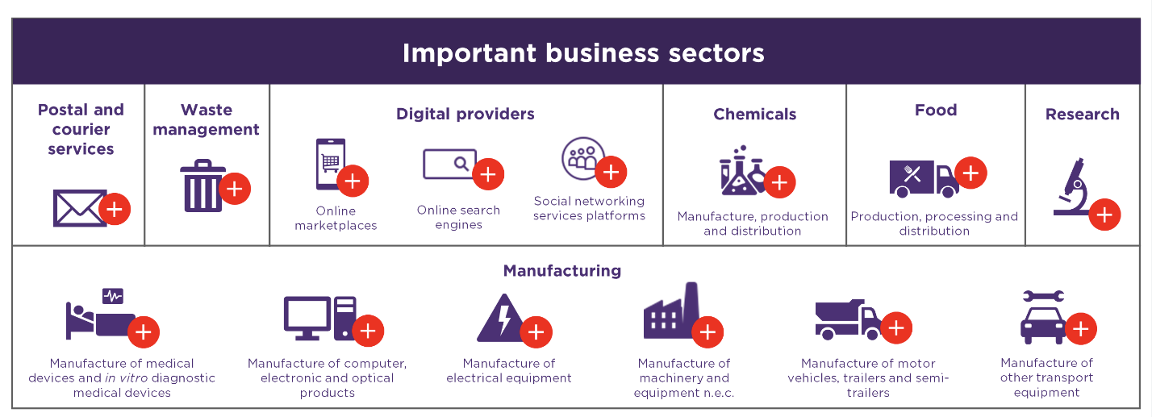
Affected industries

Slide 6
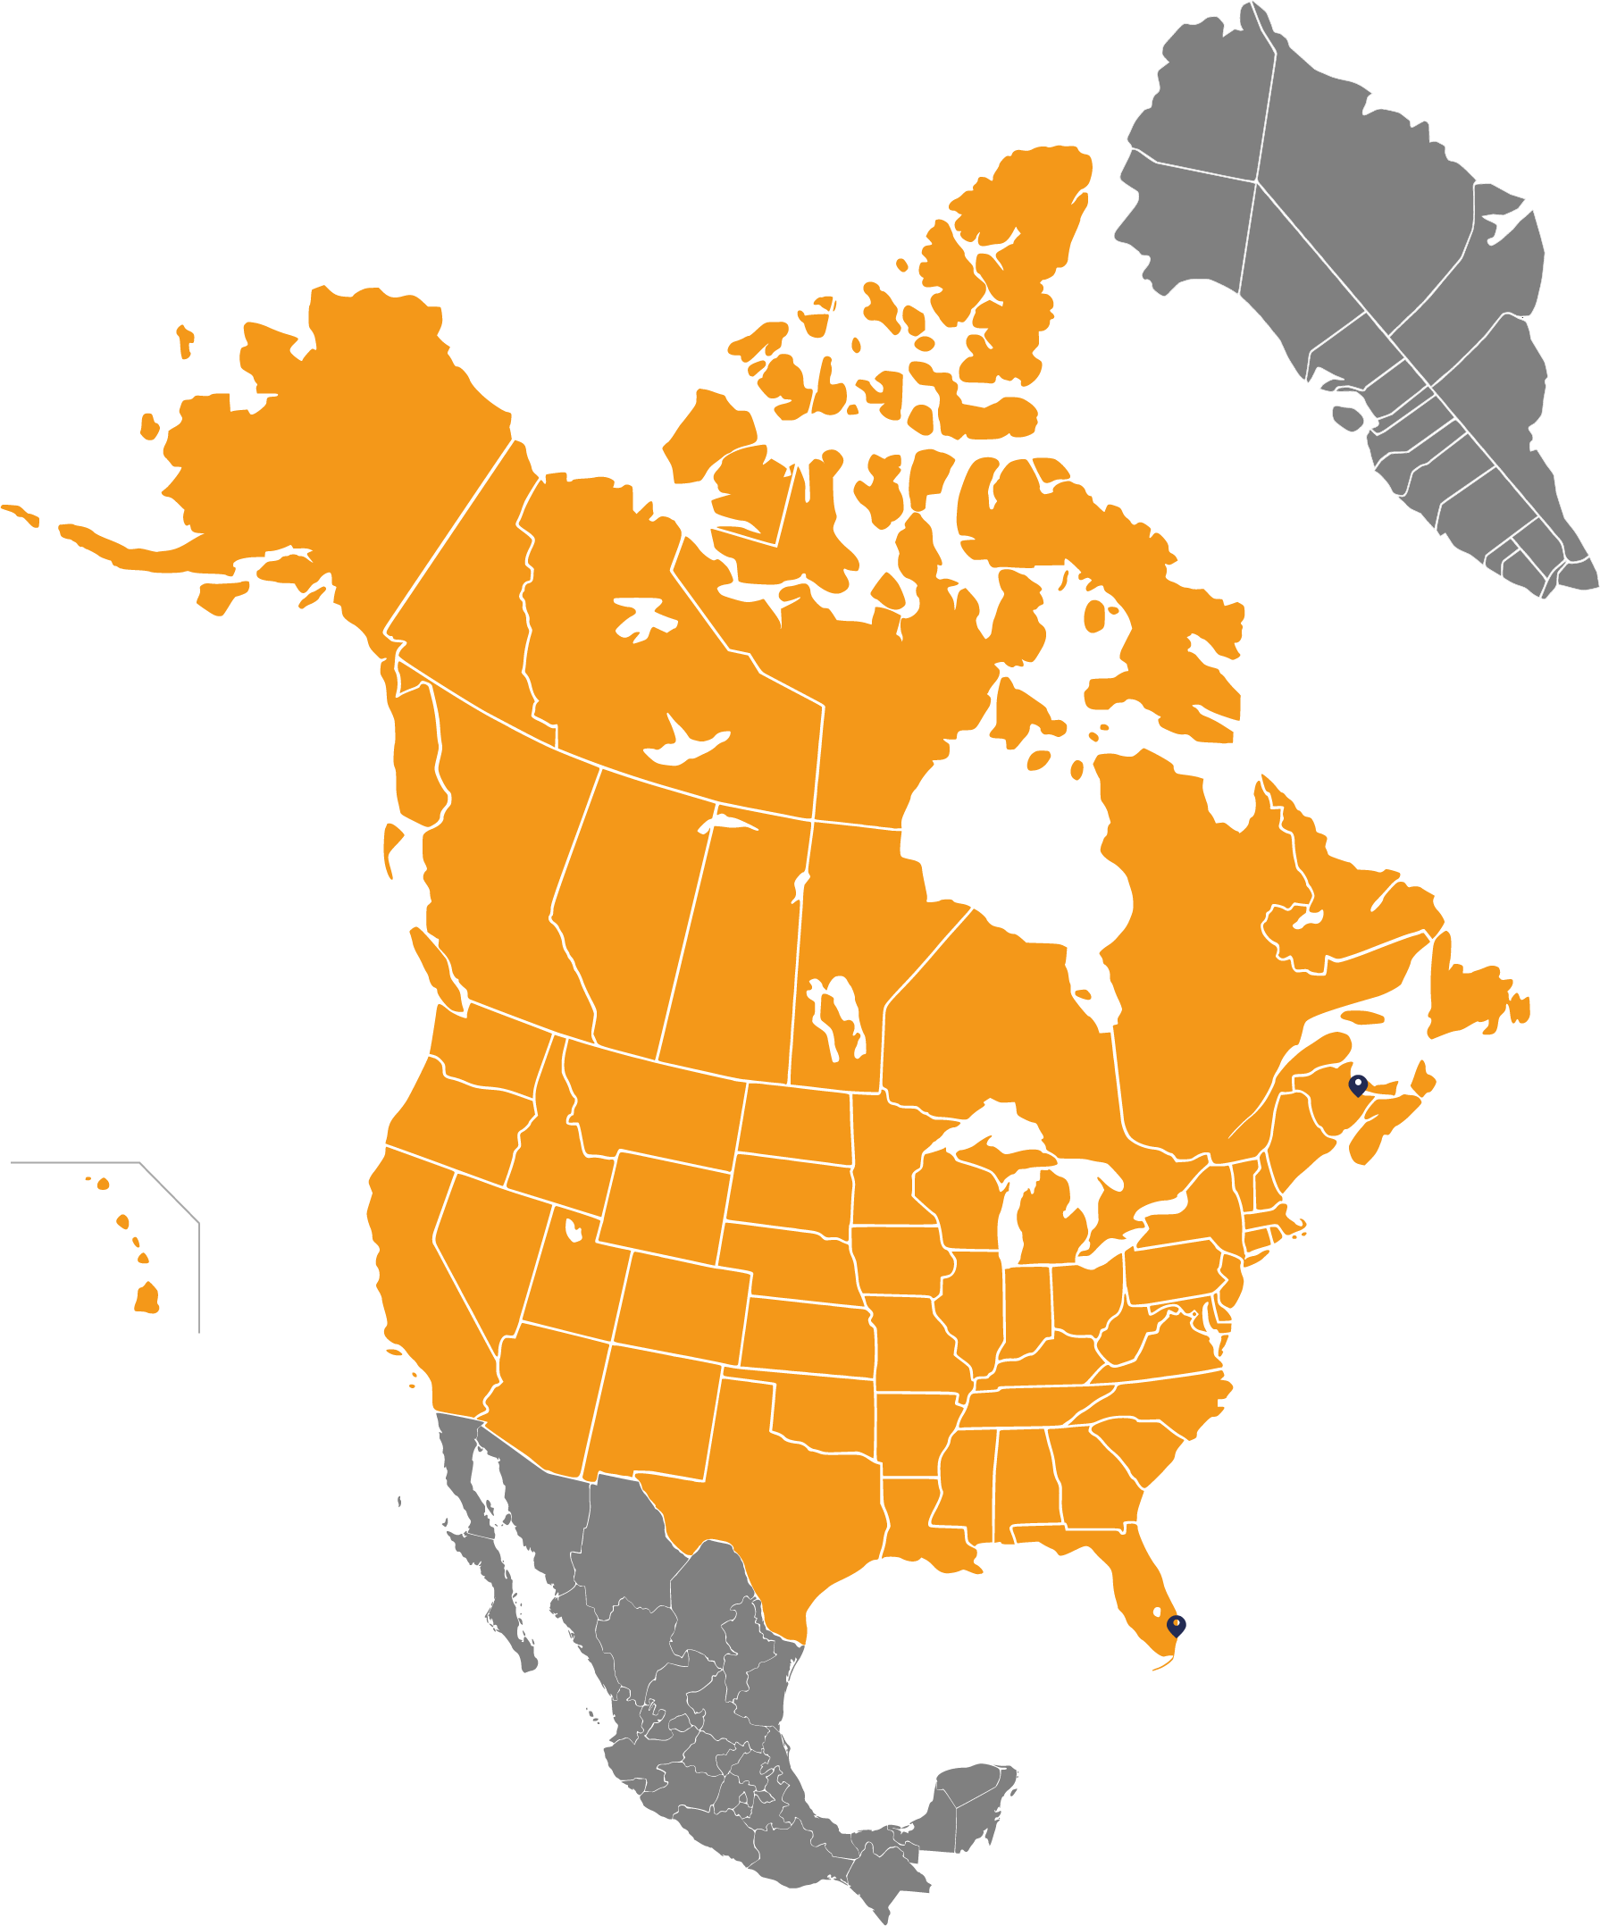
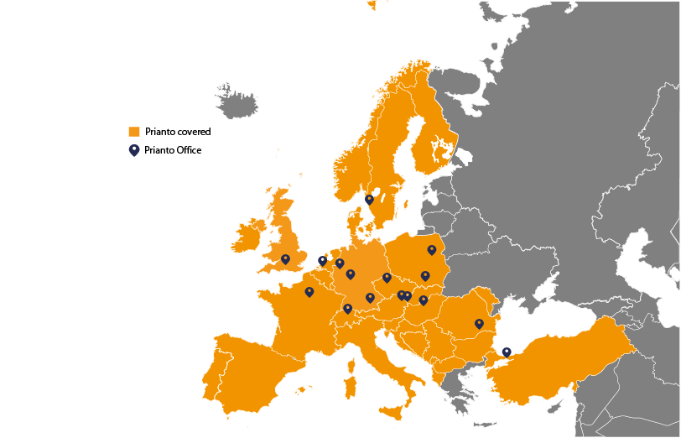
Prianto Group
  Value-Added Distributor specialized
  in Enterprise Software
  Key Technologies: cybersecurity, digitalization,
  storage, virtualization, cloud, infrastructure mgt.
  Founded in 2009
  Turnover 2023: +180M EUR
  Employees 2023: +175
  Website: www.prianto-group.com
  100% sales to IT resellers/MSPs (no direct end customer business)
  Headquarter located in Munich, Germany
  17 locations in Europe and North America
Comprehensive expert partner ecosystem
Prianto Group:
2011 – Prianto UK, Prianto Switzerland | 2019 – Prianto Canada
2012 – Prianto Austria, Prianto BeNeLux | 2021 – Prianto USA, Prianto Türkiye
2014 – Prianto Poland | 2022 – Prianto Romania and Slowakia
2016 – Prianto France | 2023 – Prianto Nordics
2017 – Prianto Czechia, Hungary, Adriatics | 2023 – Prianto Hungary Kft. foundation
Agile services
Cutting-edge
technologies

Slide 7






Services
Consultancy
Software distribution
Software procurement
Sales
support
MSP offering
Business
development
Industry 4.0
Pre-Sales
Technical support
Cybersecurity
Implementation & integration
Marketing support
Competence
Center
Digitalization
Trainings
Test systems, POC, NFR

Slide 8

Prianto as the „nerve-center” of NIS2
01
Authorities
Endcustomers
02
06
MSP/SOC providers
Experts, consultants
Qualification
Consultancy
Planning
Testing
Implementation
Support
03
IT resellers
05
Vendors
04
Notes:
Nézze meg, hogy a Prianto, partnerei bevonásával, hogyan segíthet Önnek felkészülni a NIS2 irányelvre / az új kiberbiztonsági tanúsításról és a kiberbiztonsági felügyeletről szóló törvénynek való megfelelésre:
Tanácsadás
Képzés
Végrehajtás

Slide 9
Solutions which helps to be compliant with NIS2 directive
Secure network infrastructure desig,real-time monitoring and protection
MSP/SOC solutions and services
SIEM+SOAR+BCS+EDR
implementation, incident management
IT & OT security and management technologies
Vulnerability testing and management,
penetration testing
Identity and user management,
access management and
user protection
Cyber Threat Intelligence and
Threat Hunting solutions and services
Backup-Disaster Recovery
and Business Continuity Assurance solutions
Notes:
Aki azt állítja ma magáról a piacon, hogy mindenhez ért az felelőtlenség és nagy kockázat. Nincs dobozos ajánlatunk, minden szervezet más ezért szeméyreszabott megoldással tudunk segíteni, bevonva az egyes fázisokhoz adott szakértőket. Segítünk felmérni az igényt és az alapján többszcenáriós megoldási javaslatot teszünk, erőforrásbecsléssel együtt. Annak érdekében hogy hasznos és eredményes legyen az elvégzett munka minden érintett fél részéről szükséges a proaktív együttműködés és nyitottság.
Minden cég elemi érdeke, hogy az általa bevezetett megoldások és intézkedések a kiberbiztonság erősítésére szolgáljanak és azért csak hogy pár követelményt kipipáljanak

Slide 10
















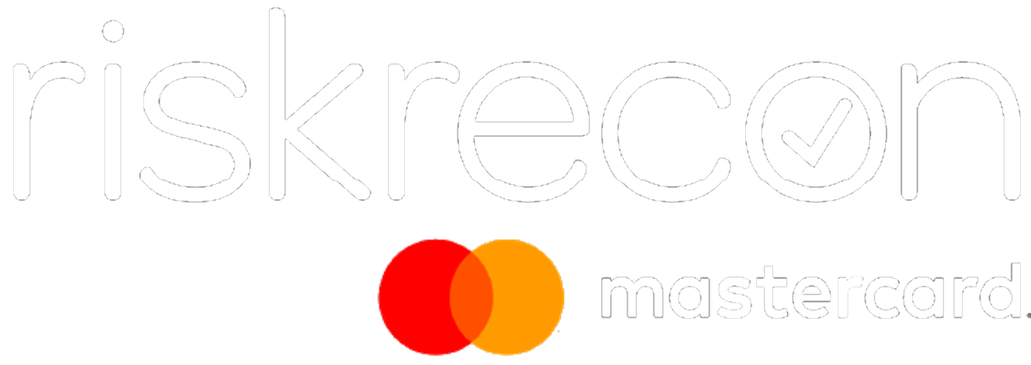









Risk assessment and analysis
Business continuity & Disaster Recovery
Network
Servers
Virtual machines,
containers
CRITICAL INFRASTRUCTURE
PRDUCTION
Applications
DATA
Cloud
Workstations
Remote work
Users
Supply Chain Security
Incident management & reporting

Slide 11








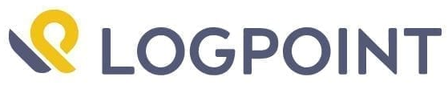
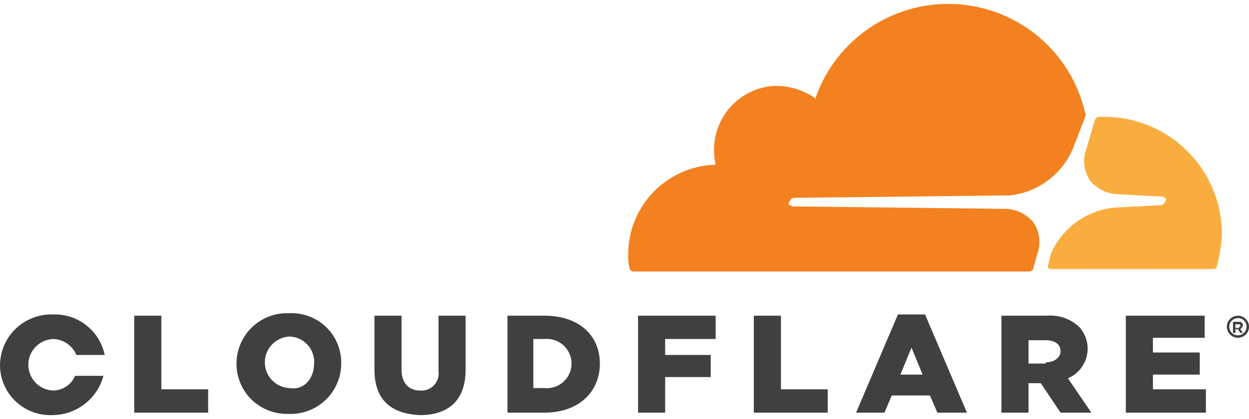


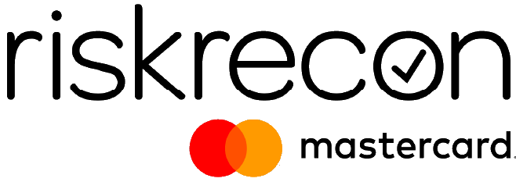

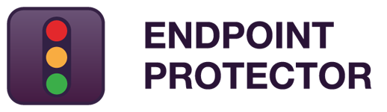

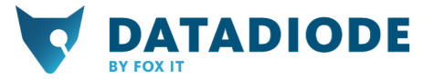








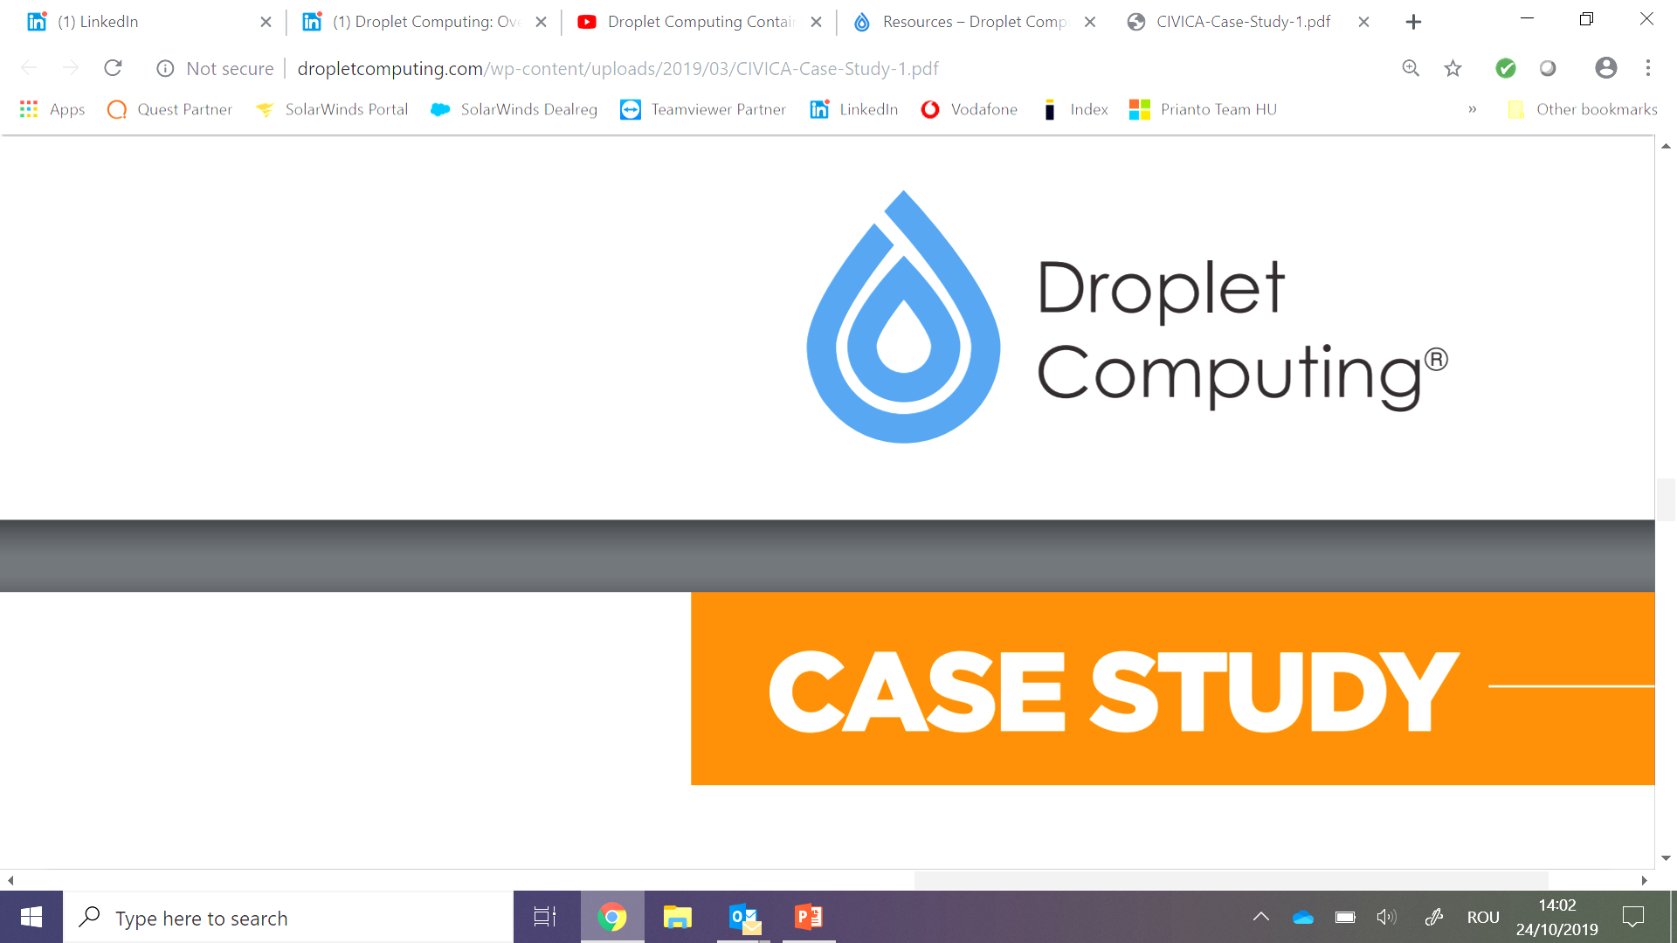







Infrastructure
Cyber Security
Data Protection
PRODUCTS & SERVICES
Identity / Access Governance
Collaboration
Vulnerability Management
Backup and Storage

Slide 12












DIGITALIZATION
SECOPS
INDUSTRY 4.0

Slide 13

Fast, flexible, reliable
Customer focus and speed are our basic principles, according to which we perform efficient, bureaucracy-free and result-oriented work at all levels of the company.
International network of experts
Our 17 international offices guarantee Prianto's simple and professional software distribution services, which are combined with modern enterprise software solutions.
Experienced professional team
Our highly qualified and willing to help team has thorough knowledge of the profession.
We always go the extra mile for our customers!
Why Prianto?
Innovative new-generation market-leading technologies
We proactively follow the next generation trends, be it IT security, digitalisation, data governance or cloud/MSP solutions.
A combination of business and technological approach
We identify profitable business opportunities for our partners that perfectly match their business goals and business strategy.
Attractive commercial conditions and cost-effective solutions
Our market-leading solutions are available with high coverage and attractive conditions, providing all the necessary support for a successful project.

Slide 14
Let`s secure NIS2 together…
better together!
Value-added softwaredistributor
Urzica Olivér / CEO
Mob: +36 70 418 7177
Email: oliver.urzica@prianto.com
Section Break
Insert the SubTitle of Your Presentation

