Slide 1


Oxana Radchenko
Regional Sales Director – Central Eastern Europe
Quest & One Identity

Slide 2




Quest is the company customers have counted on to write the software that makes their enterprise go ’round.
30+
years
4,000
employees
$1B
revenue
100
countries

Slide 3

































Around the Globe, More Than 95% of The Fortune 500 Count on Us...

Slide 4
Control the chaos now with greater visibility, greater availability and more automation.
MANAGE
Monitor, manage, migrate and replicate across multiple database environments
Manage and secure the proliferation of endpoint devices
Automate, modernize and optimize data protection in cloud/virtual, physical and hybrid environments
Database
Management
Unified Endpoint Management
Data
Protection
MODERNIZE
Move to all Microsoft platforms (Exchange, Active Directory, Office 365, SharePoint or OneDrive) on premise, in the cloud or hybrid
Manage, secure and audit hybrid AD environments
Meet audit and compliance requirements
Microsoft Platform
Management
SECURE
Achieve complete, business-driven governance
Ensure convenient, secure and compliant access
Understand and control administrator activity
Improve security and extend to the cloud without risk
Identity and Access
Management
Notes:
Our vision is to manage, monitor and move data to any number of on-prem or cloud solutions.
This means visibility into the databases so errors can be detected before they become failures Comprehensive asset management--------hardware and software-------across a wide range of operating systems and devices It also means more automation as the infrastructure becomes not only simpler but more powerful
<Examples> Thanks to Quest Database Management solutions, such as Toad, Foglight and Shareplex, we implement: Monitor, manage, migrate and replicate across multiple database environments We reduce the complexity and simplify the implementation of alternative cloud-based databases
Quest KACE - Unified EndPoint Management solution is: Managing and ensuring end point security, preventing proliferation Reducing the risk and cost of software audits.
And Data Protection solutions like Netvault and Foglight Evolve will provide an extra layer of data security by: Minimization of data center failure caused by hardware failure or security breach. Automate, modernize and optimize data protection in cloud/virtual, physical and hybrid environments
With Quest-Qorestor, we can have software-defined secondary storage that can help you store your backups in a secure and optimized way.

Slide 5
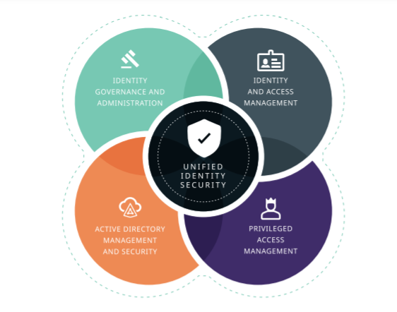
One Identity – unified identity security
Notes:
With the rise of remote working, the race to the cloud and the acceleration of digital transformation, protecting identity has never been more important.
Bad actors know there are gaps to exploit, and they are doing so at scale.
A market leader in unified identity security
A dramatic proliferation of identities, combined with the fragmented approach that many organizations address identity security today, has created unprecedented opportunities for bad actors. One Identity helps close this cybersecurity exposure gap with an integrated, modular set of solutions that delivers unparalleled visibility, control, and protection.
Pictured here is the emerging model that is unified.
Identity is at the center – and people, applications, and data are all aligned as one.
This allows you to verify everything
In contrast to the old way of doing things, this new identity-centric model allows you to:
Harden privilege…instead of endpoints;
Ensure all identities are correlated and visible;
Remove friction with better integration;
Manage identity consistently; and
Better and more quickly add, remove, and adjust privilege just in time.
This is the unified identity security strategy that many are adopting.

Slide 6



Trusted and proven
80
100
1,000
11,000+ enterprise customers
out of the
Fortune
Common Criteria certified*
as customers
partners
around the globe
* Identity Manager and Safeguard product lines
500M+ identities
actively managed
97%
20+ years
customer
satisfaction
in identity security
worldwide
Notes:
We are battle tested:
One Identity has 80 of the Fortune 100 as customers;
11,000 customers around the globe;
500 million identities on behalf of our customers;
More than 1,000 partners;
Almost a 100% customer sat score; and
We’ve been in business for more than 20 years

Slide 7

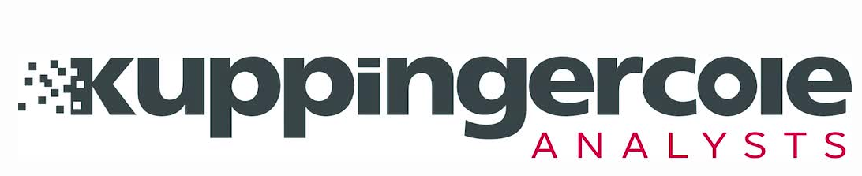
A market leader
Key Identity-Centric Markets
Privileged Access Management
Privileged Access Management
Access Management
Identity Governance & Administration
Identity Governance & Administration
Gartner® Magic QuadrantTM
(2021)
KuppingerCole Leadership Compass
(2021)
Gartner® Magic QuadrantTM
(2021)
KuppingerCole Leadership Compass
(2021)
Gartner® Magic QuadrantTM
(2019)
* Gartner does not endorse any vendor, product or service depicted in its research publications, and does not advise technology users to select only those vendors with the highest ratings or other designation. Gartner research publications consist of the opinions of Gartner's research organization and should not be construed as statements of fact. Gartner disclaims all warranties, expressed or implied, with respect to this research, including any warranties of merchantability or fitness for a particular purpose. This graphic was published by Gartner, Inc. as part of a larger research document and should be evaluated in the context of the entire document. The Gartner document is available upon request from One Identity. GARTNER and MAGIC QUADRANT are registered trademark and service mark of Gartner, Inc. and/or its affiliates in the U.S. and internationally and are used herein with permission. All rights reserved.
Notes:
As a result, we have established clear market leadership across the board.
Internal notes:
The Access Management Magic Quadrant is related to OneLogin

Slide 8


Continuously maps all attack paths in Active Directory
Prioritizes and quantifies attack path choke points
Monitors and measures improved security posture
Provides precise, practical remediation guidance
Notes:
BloodHound Enterprise provides…

Slide 9
Hybrid AD cyber resilience lifecycle
Improve response time and resilience during & after attacks
Identify
SpecterOps BloodHound Enterprise
Protect
Change Auditor / GPOADmin
Detect
On Demand Audit Hybrid Suite
Respond
+IT Security Search
Recover
+Recovery Manager DRE / On Demand Recovery
Notes:
Quickly recovers domains or an entire AD forest from an attack
Restores unwanted changes to any object including users, GPOs and AD configuration
Roll-back AD when remediations have unintended consequences
Revert unapproved changes to Azure AD objects and configuration

Slide 10
Thank you!

