Slide 1

Cisco Security & AI
Žan Črnivec, Solutions Engineer – Global Virtual Sales
zcrnivec@cisco.com
May 2024

Slide 2
97% of companies say the urgency to deploy AI powered technology has increased but only 14% of organizations worldwide are fully ready to integrate AI into their businesses.
Cisco AI Readiness Index 2024

Slide 3



The Next Decade In Enterprise AI
More AI
More Data
Fewer Products
Enterprise adoption of AI will accelerate over the next decade
Products built with broader
data stores will have bigger success in the market
Consolidation of the security
stack will continue
Security. Simplified.

Slide 4
AI Assistants that change the way humans and machines interact with each other
Experience
Data
Efficacy
Assist
Models
Why?
How?
Economics
What?
Governance
Augment
Automate
Correlating insights at machine-speed, creating a 10x return on human effort
Automating complex workflows that make the lives of security admins easier
Notes:
As we continue injecting AI across our portfolio, our teams align themselves around three key pillars to ensure that we are delivering these AI experiences to our customers thoughtfully but on an accelerated timeline
These pillars are:
Data
Models
Governance
To be an AI-first company, you have to be a Data-first company. At Cisco, we capture more machine telemetry at scale to feed intelligence across the portfolio that is unmatched in the industry. Particularly in security, scale matters in determination, in remediation, and in prevention. Our visibility drives unrivaled AI-driven insights spanning devices, applications, security, networks, and the internet.
We combine this advantage we have with data, with our ability to custom build models from scratch. We leverage the best of breed models that include open source models like LLama2, or 3rd party models like GPT4 or homegrown models, depending on each customer use case.
Our customers trust us with their data because we believe that privacy is a fundamental human right. Our entire focus is on increasing customer trust by helping them connect, automate, and stay resilient in an AI-dominated, cloud-first world. At Cisco, we believe Responsible AI is non-negotiable. When it comes to AI, a trusted business partner is needed as much as an algorithm.

Slide 5
We Are Injecting AI Across The Portfolio
Cisco Security Cloud
Assist
AI Assistant Experience
Give your admins superpowers.
Simplify management, improve outcomes.
Breach Protection
Augment
AI Powered Detection
User Protection
Correlate 550B security events at machine-speed.
Cloud Protection
Automate
Autonomous Actions
Learn from human-to-machine interactions to automate complex playbooks.
Firewall Foundation
Notes:
The security portfolio is incredibly broad.
You can think of our security portfolio as three simple use cases, or suites of capabilities.
And inside each one of these suites of capabilities, we are injecting AI in 3 distinct but connected ways.

Slide 6
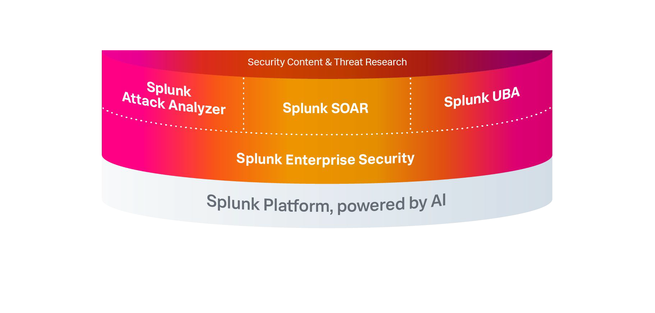



Powering the SOC of the future
with the leading TDIR solution
- - SaaS
On-Prem / BYOL
Avail. standalone
Notes:
Threat Detection, Investigation, Response

Slide 7

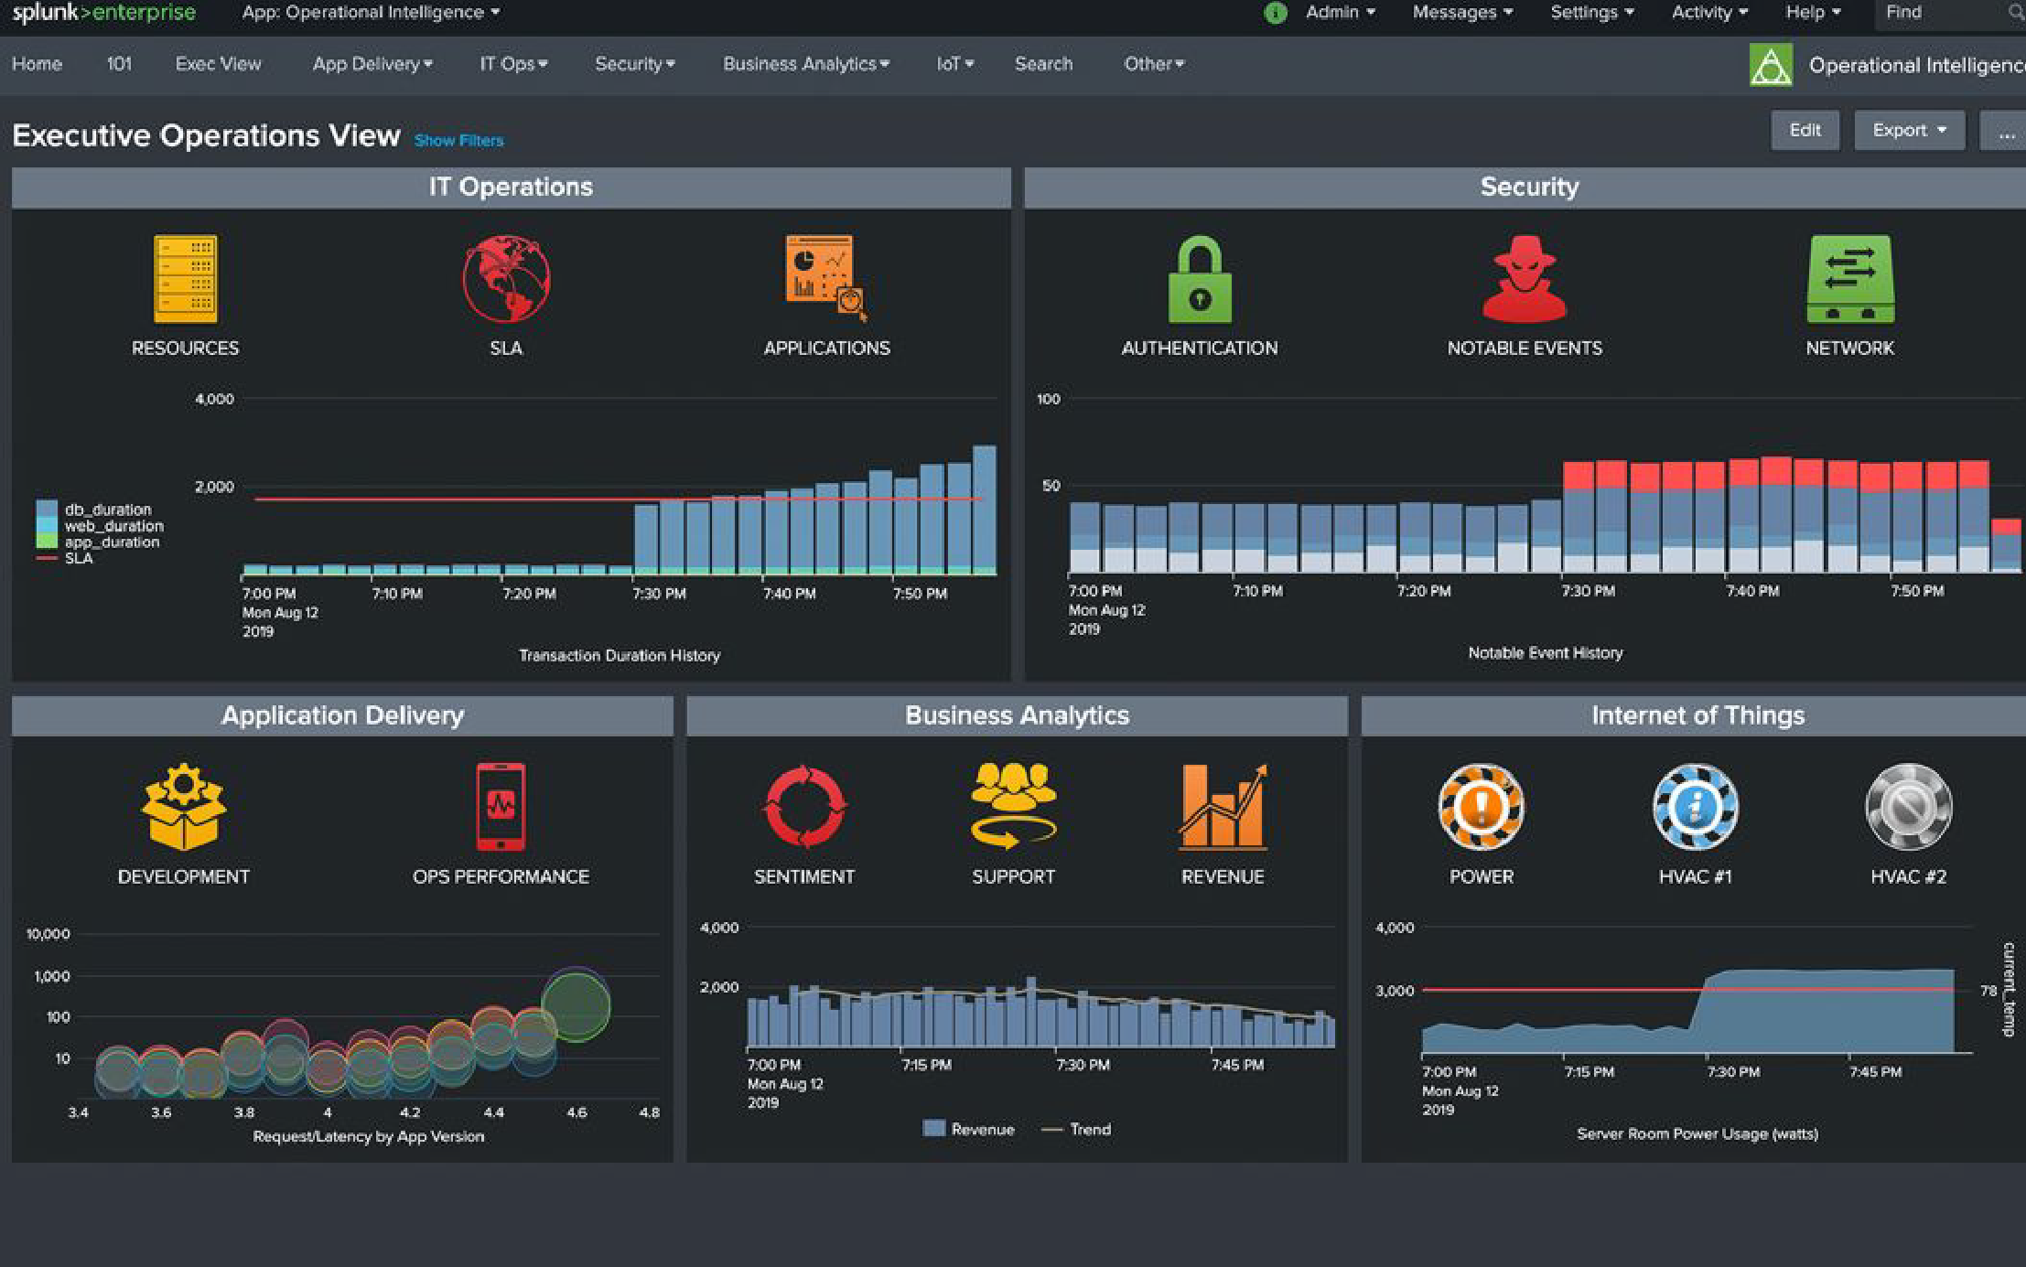
Splunk Enterprise
Powerful machine data aggregation, search, reporting and alerting
Expansive data access
Flexible data onboarding
Full-ﬁdelity investigation
Real-time alerting
Build custom apps
SaaS or self-managed

Slide 8


© 2024 SPLUNK INC.
Splunk Enterprise Security is an industry-deﬁning SIEM and security analytics solution trusted by SOCs around the globe. Its powerful capabilities enable you to realize comprehensive visibility, empower accurate detection with context, and fuel operational efficiency.

Slide 9
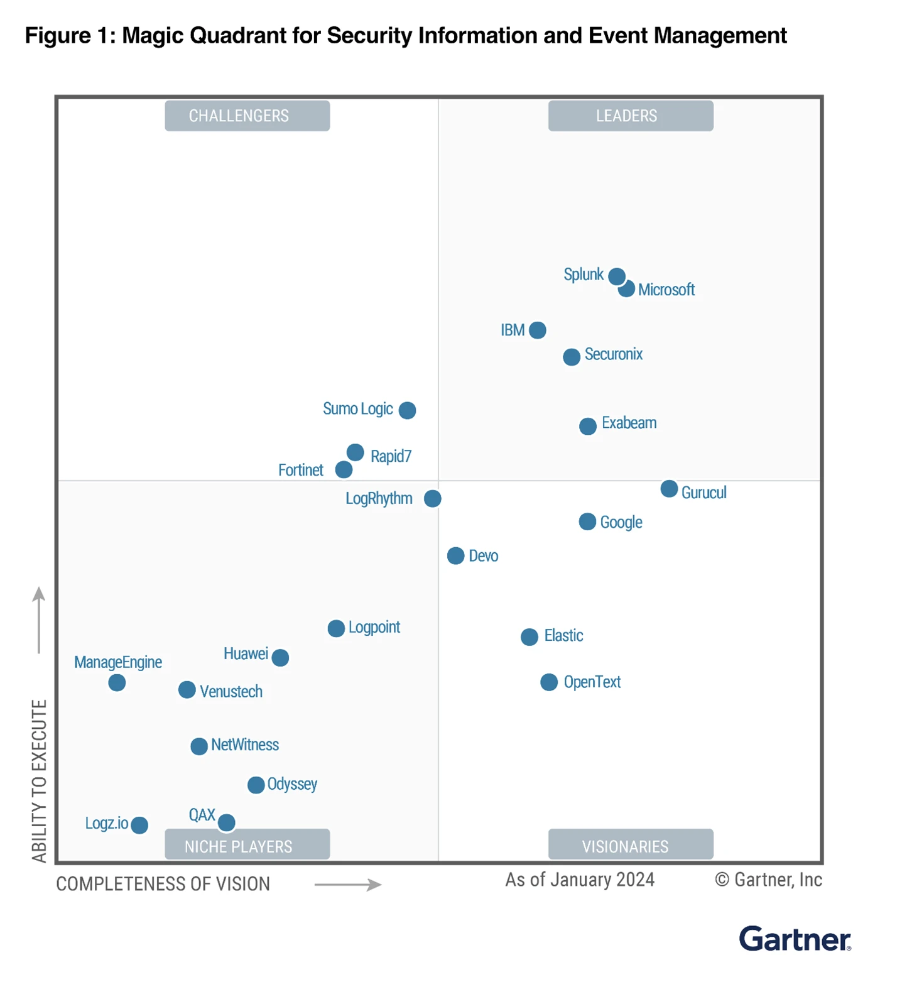
© 2024 SPLUNK INC.
Splunk Enterprise Security is an industry-deﬁning SIEM and security analytics solution trusted by SOCs around the globe. Its powerful capabilities enable you to realize comprehensive visibility, empower accurate detection with context, and fuel operational efficiency.

Slide 10
Traditional SIEM Alerting
Traditionally, the events below would be considered too noisy and would be abandoned
6:55AM 6:58AM 7:03AM 1:55PM 2:03PM 2:07PM
2:15PM
Potential | Suspicious | Suspicious Powershell | AWS ACLs | AWS user | AWS buckets | AWS permanent
spear | command | observed | opened up all | provisioning | created | creation
phishing | disabling |  | access | observed |  | observed
observed | controls

Slide 11

Risk-Based Alerting
With risk-based alerting, these events become context that informs high-ﬁdelity alerts
6:55AM 6:58AM 7:03AM 1:55PM 2:03PM 2:07PM
2:15PM
Potential spear phishing observed 10 pts
Suspicious command disabling controls 15 pts
Suspicious Powershell observed
20 pts
AWS ACLs
opened up all access
10 pts
AWS user provisioning observed 15 pts
AWS buckets created
15 pts
AWS permanent creation observed
20 pts
With one click, view all of the risk events that contribute to the alert
Risk Incident Rule:
ALERT
Generate alert for any user or system that exceeds a risk score of 100 in a 24
hour period
Aggregated user risk score >100

Slide 12

















Use Case Keywords
Security Monitoring & Analysis
Advanced & Insider Threat Detection
Incident Investigation & Forensics
Incident Response
Compliance
Threat Hunting
© 2024 SPLUNK INC.

Slide 13
Cybersecurity + AI – More Important Now Than Ever
AI-Based Threats
Almost Human
Very Real Content
Gen AI a powerful tool in attacker toolkit to increase volume and scope of attacks
Identity impersonation has never been easier through voice, video, and email impersonation
Disinformation can now spread faster than ever before because the content looks very real

Slide 14
Security That Only Cisco Can Deliver
AI-First Cisco Security Cloud
Cisco Breach Protection
Powered by the Talos threat intelligence team
Extended Detection & Response
Cisco User Protection
Cisco Cloud Protection
Posture & Auth Management
Endpoint Security
Workload Security
Email Security
Experience Insights
Application Security
Remote Browser Isolation
Network Access Control
Vulnerability Management
Full Stack Observability
Security Service Edge
Multicloud Defense
Firewall Protection
Notes:
Think of our security portfolio as three simple use cases, or suites of capabilities:
We have user protection focused on everything for an end user.
There's a suite of capabilities that extend that same zero trust philosophy for applications, whether the live in the private or public cloud.
And then there is a suite of capabilities powered by a combination of human intelligence and AI to stop breaches like ransomware.
And Cisco is one of very very few platform providers that have our depth and we are the best where security meets the network.
Only Cisco and the platform advantage of Cisco Security Cloud can deliver experiences that are better for users, easier for IT, optimized for developers and safer for everyone

Slide 16
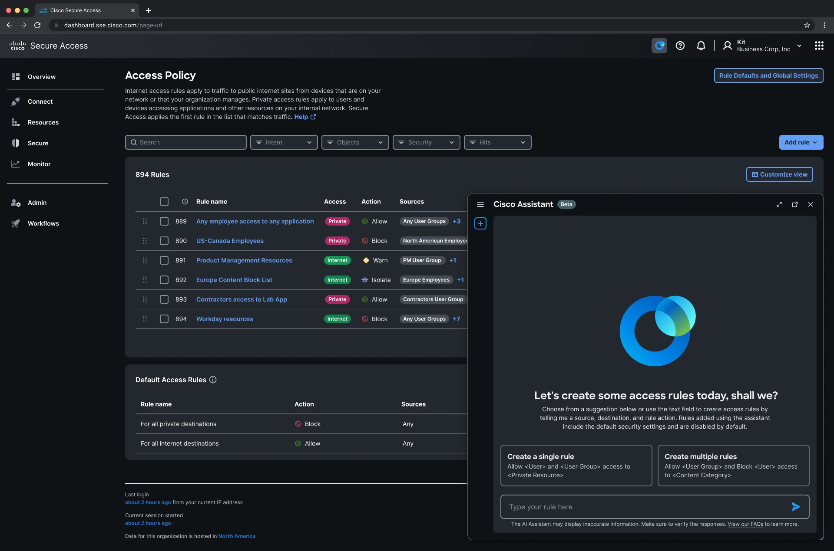
AI Assistant in Secure Access
Use-Cases Driven by Customer Feedback
Simplify and speed up policy administration by 70%
Reduce human error with automatic error handling prompts.
Notes:
The security portfolio is incredibly broad.
You can think of our security portfolio as three simple use cases, or suites of capabilities.
And inside each one of these suites of capabilities, we are injecting AI in 3 distinct but connected ways.

Slide 17
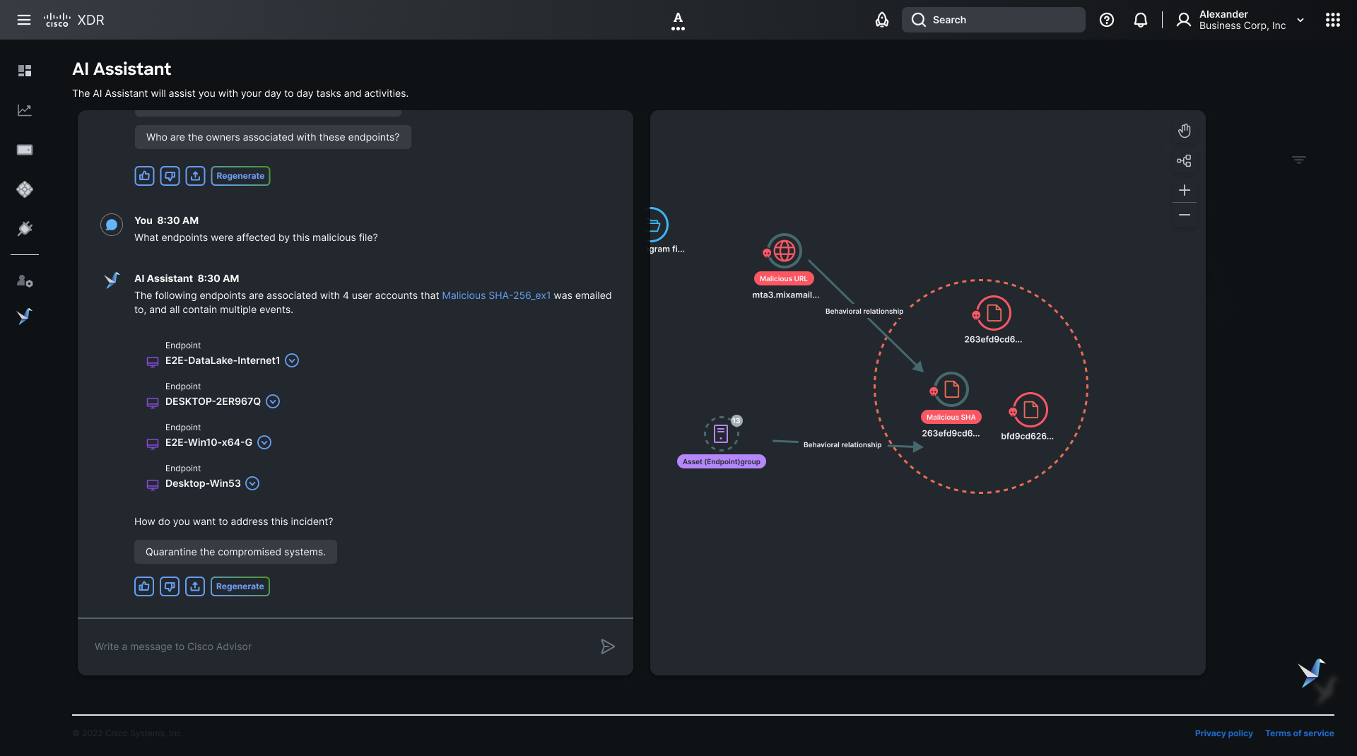
AI Assistant in XDR
Use-Cases Driven by Customer Feedback
FUTURE
Recommend actions
Investigate IOCs
Get incident summaries
Notes:
The security portfolio is incredibly broad.
You can think of our security portfolio as three simple use cases, or suites of capabilities.
And inside each one of these suites of capabilities, we are injecting AI in 3 distinct but connected ways.

Slide 18

AI Assistant
Bringing the suites together
Cisco XDR
Cisco Defense Orchestrator
Cisco Duo
Detects a phishing attack that has setup a “command and control” and is exfiltrating data outside the network.
Block any outbound
exfiltration to the IP address identified by the XDR
Lock affected user
out of critical applications
Opportunities
Challenges
One single Assistant
Natural Language
Automated workflows
Multiple dashboards
Training to use different consoles
Approvals, permissions
Notes:
The security portfolio is incredibly broad.
You can think of our security portfolio as three simple use cases, or suites of capabilities.
And inside each one of these suites of capabilities, we are injecting AI in 3 distinct but connected ways.

Slide 19
AI Assistant
Bringing the Suites Together
1
1
AI Assistant in XDR allows Remi to request a firewall rule to be added.
Notes:
The security portfolio is incredibly broad.
You can think of our security portfolio as three simple use cases, or suites of capabilities.
And inside each one of these suites of capabilities, we are injecting AI in 3 distinct but connected ways.

Slide 20
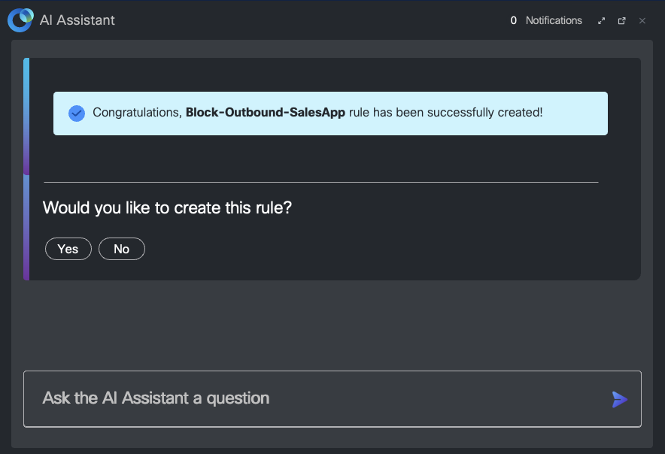
AI Assistant
1
AI Assistant in XDR allows Remi to request a firewall rule to be added.
2
One click from the Assistant allows Remi to navigate to CDO with all context of attack shared across the two.
1
Detects a phishing attack that has setup a C&C and is exfiltrating data outside the network.
2
Block any outbound exfiltration to the IP address identified from the C&C.
Notes:
The security portfolio is incredibly broad.
You can think of our security portfolio as three simple use cases, or suites of capabilities.
And inside each one of these suites of capabilities, we are injecting AI in 3 distinct but connected ways.

Slide 21
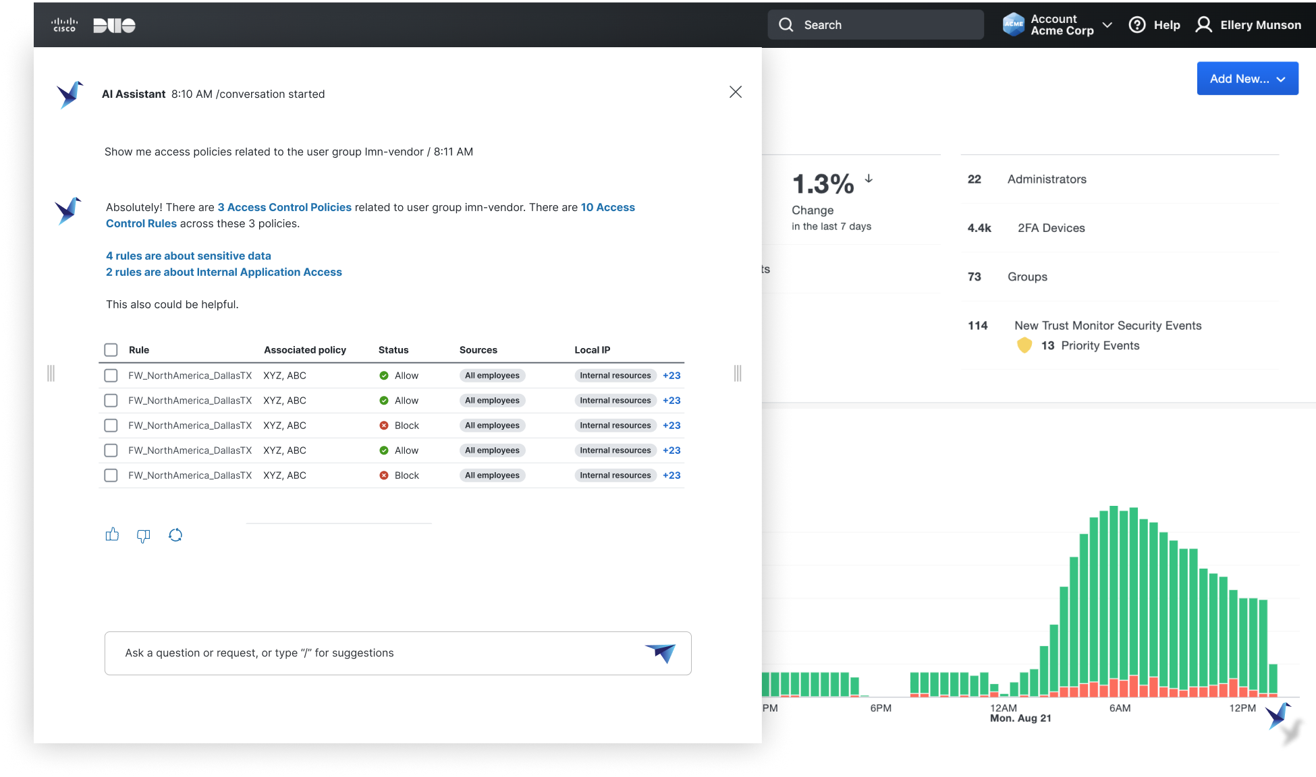
AI Assistant
3
A request to lock Lee's laptop is made from the AI Assistant in CDO.
4
One click from the AI Assistant allows Remi to navigate to Duo Console with context of attack shared across the two.
Block any outbound exfiltration to the IP address identified from the C&C
Lock affected user out of critical applications
3
4
Notes:
The security portfolio is incredibly broad.
You can think of our security portfolio as three simple use cases, or suites of capabilities.
And inside each one of these suites of capabilities, we are injecting AI in 3 distinct but connected ways.

Slide 22
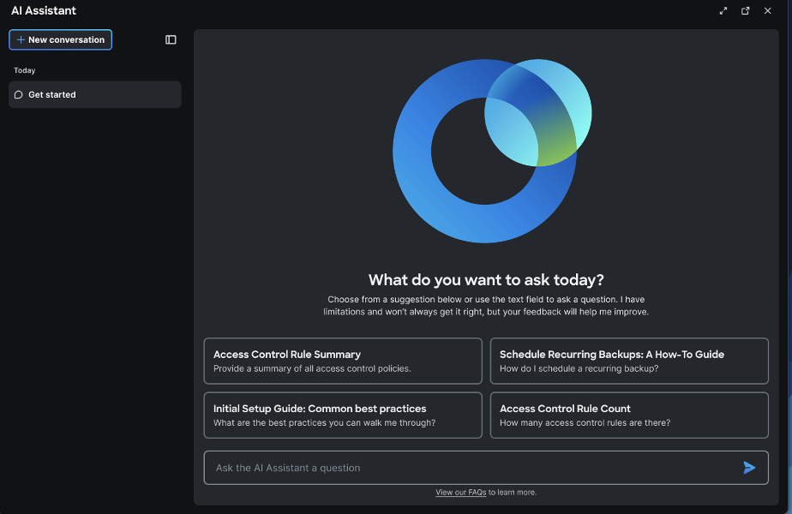
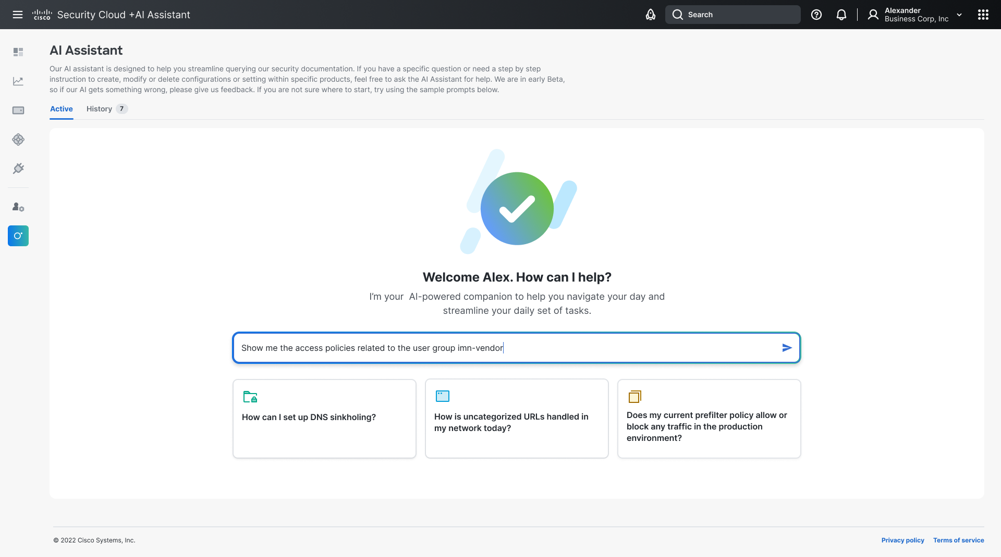
AI Assistant
Bringing the suites together
Embedded Mode
Unified Mode
Cisco XDR
Cisco Defense Orchestrator
Cisco Duo
AI Assistant
Detects a phishing attack that has setup “command and control” and is exfiltrating data outside the network.
Block any outbound exfiltration to the IP address identified by the XDR
Lock affected user out of critical applications
Unified mode provides a single place for you to communicate with all products in the suites without going into each console.
Notes:
The security portfolio is incredibly broad.
You can think of our security portfolio as three simple use cases, or suites of capabilities.
And inside each one of these suites of capabilities, we are injecting AI in 3 distinct but connected ways.

Slide 23
AI Beyond Assistants
AI Assistant Experience
Breach Protection
Assist
Give your admins superpowers.
Simplify management, improve outcomes.
XDR Risk Scores NN for MITRE ATT&CK mining​
XDR Alert Summarization​
XDR Global Intelligence Models​
TALOS Signature Generation AutoML
User Protection
Augment
AI Powered Detection
Email Threat Defense (HuggingFace, spaCy, NER)
Correlate 550B security events a day at machine-speed.
Duo Trust Monitor Unsupervised Learning​
Anomaly detection in industrial processes (IoT)
Umbrella NN (+SVM + Supervised) ​
Cloud Protection
Automate
Autonomous Actions
Vulnerability Management Risk Scores (VM+VI)​
Learn from human-to-machine interactions to automate complex playbooks.
Firewall
Encryption Visibility Engine

Slide 24


Talos Powers The Cisco Portfolio With Intelligence
500
AI
threat researchers
powered algorithms
550B
security events observed daily
Notes:
The reason our security efficacy is high, is that we process a lot of information from many sources of telemetry
​
To distinguish friend from foe, we look at more than 550Billion security events per day. (and we're discovering more than 2 million brand new malware samples every day) We have a very deep bench of technical expertise. We have more than 500 people working in various capacity with our Talos group for threat research. ​
We employ AI-powered detection, which uses predictive AI and analytics to correlate events and data at machine scale. ​
​
​
​

Slide 25
Visibility into encrypted channels
Add detail screenshot push left
TLS Client Hello
Process
Cipher Suite: TLS_AES_128_GCM_SdsafHA256 (AX1301)
Cipher Suite: TLS_AES_128_GCM_SHA256 (AX1301)
Cipher Suite: TLS_AES_128_GCM_Sasdf HA256 (AX1301)
Cipher Suite: TLS_AES_128_GCM_SHA256 (AX1301)
Cipher Suite: TLS_AES_128_GCM_SdsafHA256 (AX1301)
Cipher Suite: TLS_AES_128_GCM_ 256 (AX1301)
Cipher Suite: TLS_AES_128_GCM_SHA256 (AX1301)
Operating system
Process
Operating system
Browser
Signature version
Browser
Signature version

Slide 26
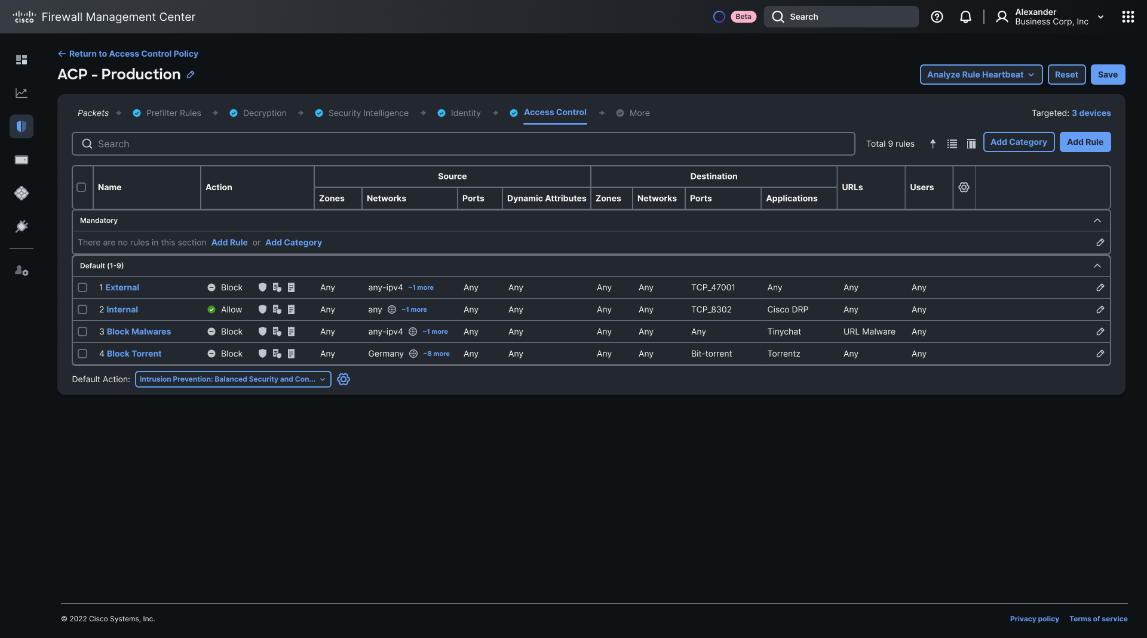
Block Malware
Block
Any
Any-ipv4
~1 more

Slide 27
Augment: Zero Day Attack Detection Using LSTMs
$ snort \
-q --talos --plugin-path . \
--lua 'kaizen = { model = "model.tflite" };' \
-r 2023-26876-none-none-XXXX-1.pcap
URI: "/admin.php?page=history&filter_image_id=1&filter_user_id=12 UNION ALL SELECT CONCAT(0x41414141,username,0x3a,password,0x41414141) from piwigo_users where id=1-- --"
LSTM output: 0.988226
##### 2023-26876-none-none-XXXX-1.pcap #####
[200:1:0] (kaizen) exploit payload detected (alerts: 1)
#####

Slide 28
Secure Access: protecting the usage of AI
Protect intellectual property as it flows in and out of AI systems
Threat Visibility
Leakage Prevention
Threat Prevention
Discover and
Assess Activities
DLP Inspection of Prompts/Uploads
Block Apps and
Control Downloads
Discovers and controls more than 70 Gen AI apps (including APIs)
Notes:
Greater Detection and Control
Deepen visibility into AI usage by discovering 70 Generative AI applications and APIs
Secures the use of Generative AI applications via discovery, block/allow, granular control, and inline data loss prevention (DLP).
Grants the ability to block downloads of unsafe content.
Block or allow multiple generative AI applications via DNS-layer security and secure web gateway policies.
Policy management for all these capabilities is done via Secure Access’s single, unified dashboard.

Slide 29
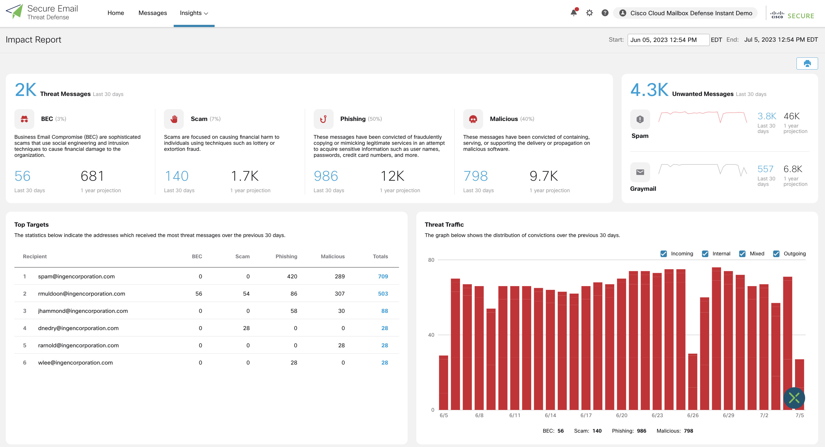
Augment: Email Threat Defense
Goal
Simultaneously evaluate different portions of an incoming email for markers of malicious intent.
AI in Use
Natural Language Understanding + ML + LLM
  30+ Detectors
  Natural Language Processing
  Image Processing
Notes:
Faster analysis and triage for email-based threats targeting end users, often not caught by Microsoft 365.

Slide 30
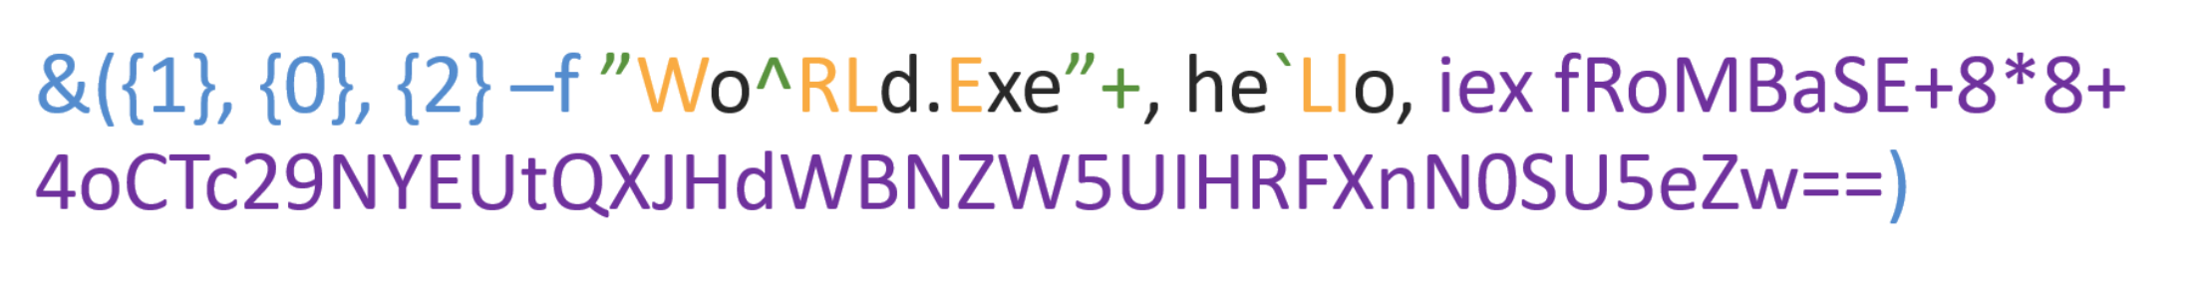
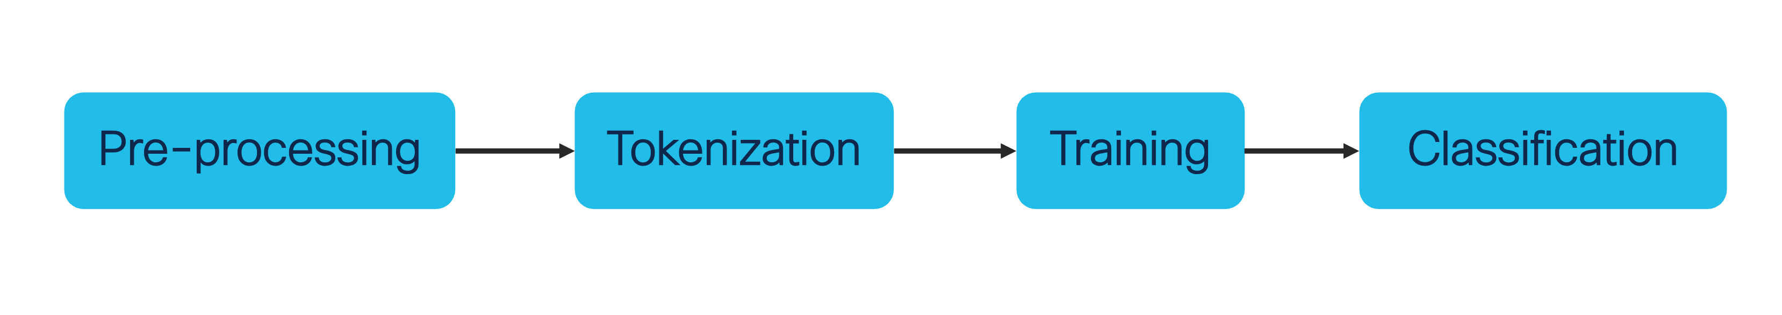
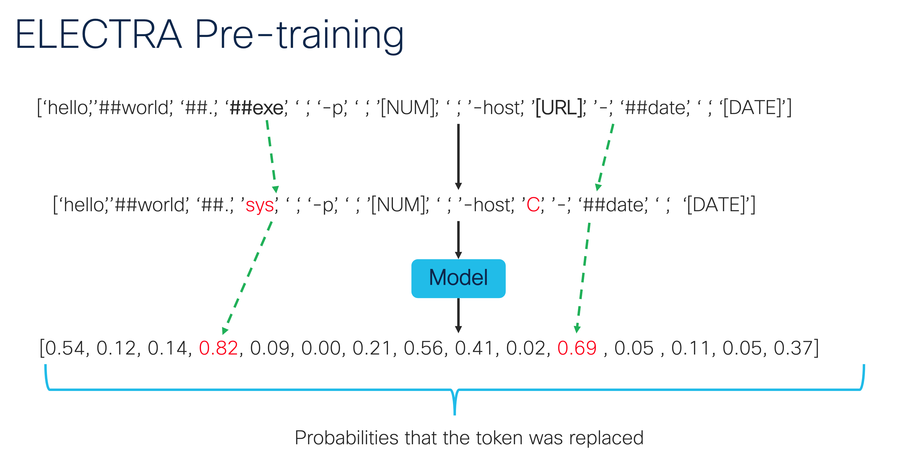
Augment: CLI Obfuscation Detection
Goal
Detect obfuscated command
AI in Use
Fine-tuned Language Models & NLP
  Combination of tokenizer and classifier
  Small and highly accurate mode

Slide 31
AI Beyond Assistants
Cisco Security Cloud
Assist
AI Assistant Experience
Give your admins superpowers.
Simplify management, improve outcomes.
Breach Protection
Augment
AI Powered Detection
User Protection
Correlate 550B security events a day at machine-speed.
Cloud Protection
Automate
Autonomous Actions
Learn from human-to-machine interactions to automate complex playbooks.
Firewall Foundation

Slide 32

RANSOMWARE

Slide 33
Snapshot of good
state taken
Suspicious process attempts to connect
to application
Connection made,
app infected
Zero RPO
1100100 01 0
0110 01 10101
App
01 01010 01
App
Notes:
Im on a laptop, something starts to happen not normal (processes)… system says is this laptop connected to an app? Before it connects, it takes snapshot of good state of app… if snapshot is ok, it will kill it… if it is bad, kills connection and recovers. Instead, it is triggered because it sees something weird… malware bug.. BEFORE it connects snapshot
Show laptop does connect and

Slide 34
AI-driven Autonomous Security Outcomes
Automated
Summaries
Next Best
Action
Incident
Reporting
Webex
War Rooms
Playbook
Recommendation
Playbook
Automation
Autonomous Actions
Learn from human-to-machine interactions to automate complex playbooks.

